Slide 1
Chapter 4
The Processor

Slide 2
Introduction
§4.1 Introduction
CPU performance factors
Instruction count
Determined by ISA and compiler
CPI and Cycle time
Determined by CPU hardware
We will examine two MIPS implementations
A simplified version
A more realistic pipelined version
Simple subset, shows most aspects
Memory reference: lw, sw
Arithmetic/logical: add, sub, and, or, slt
Control transfer: beq, j

Slide 3
Instruction Execution
PC → instruction memory, fetch instruction
Register numbers → register file, read registers
Depending on instruction class
Use ALU to calculate
Arithmetic result
Memory address for load/store
Branch target address
Access data memory for load/store
PC ← target address or PC + 4

Slide 4
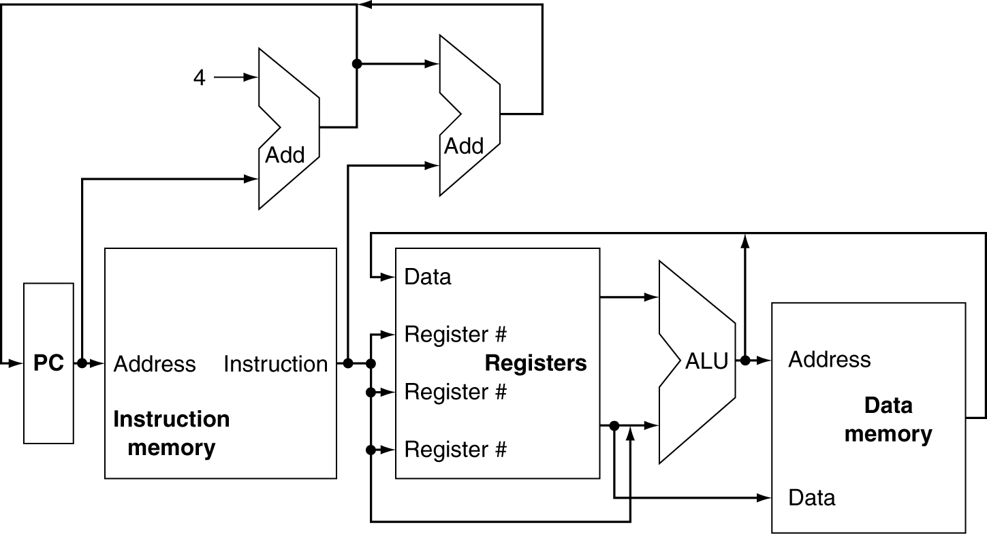
CPU Overview

Slide 5
Multiplexers
Can’t just join wires together
Use multiplexers

Slide 6
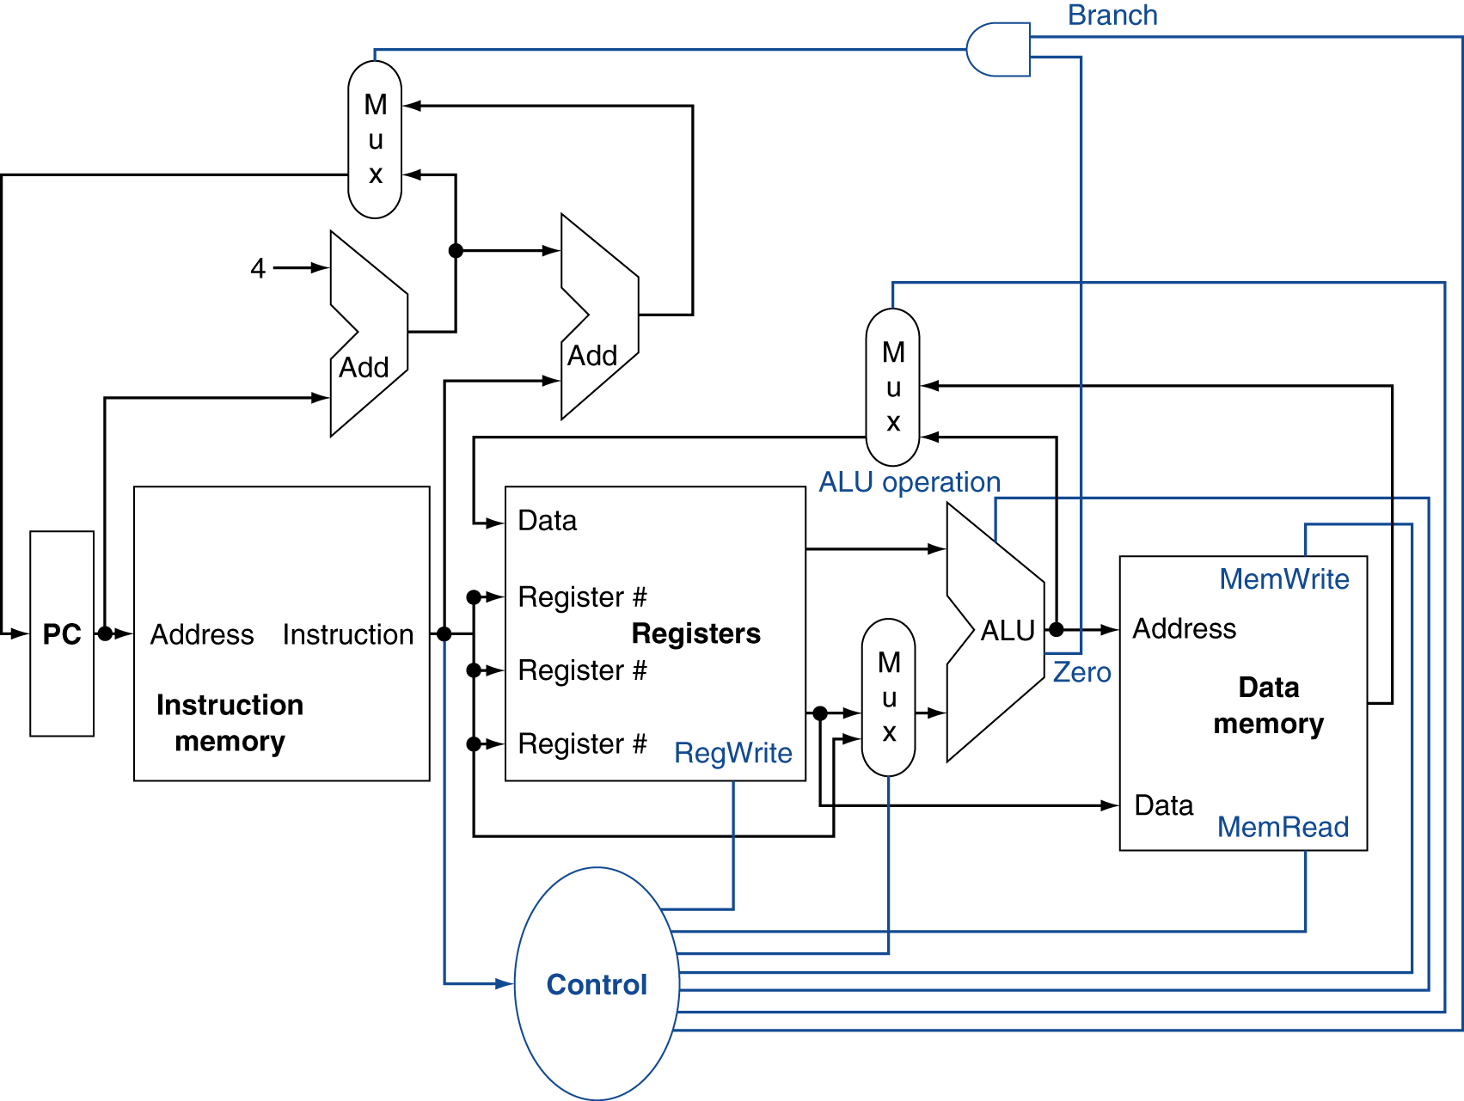
Control

Slide 7
Logic Design Basics
Information encoded in binary
Low voltage = 0, High voltage = 1
One wire per bit
Multi-bit data encoded on multi-wire buses
Combinational element
Operate on data
Output is a function of input
State (sequential) elements
Store information
§4.2 Logic Design Conventions

Slide 8
Combinational Elements
AND-gate
Y = A & B
Adder
Y = A + B
A
+
Y
B
A
Y
B
Arithmetic/Logic Unit
Y = F(A, B)
Multiplexer
Y = S ? I1 : I0
A
I0
M u x
Y
Y
ALU
I1
B
S
F

Slide 9
Sequential Elements
Register: stores data in a circuit
Uses a clock signal to determine when to update the stored value
Edge-triggered: update when Clk changes from 0 to 1
Clk
D
Q
D
Clk
Q

Slide 10
Sequential Elements
Register with write control
Only updates on clock edge when write control input is 1
Used when stored value is required later
Clk
D
Q
Write
Write
D
Clk
Q

Slide 11
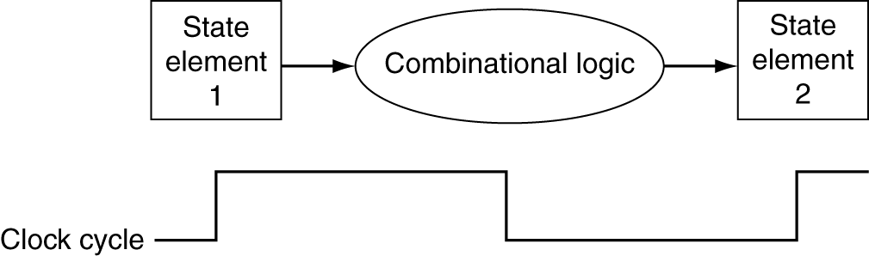
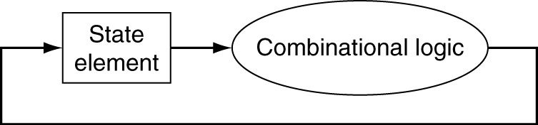
Clocking Methodology
Combinational logic transforms data during clock cycles
Between clock edges
Input from state elements, output to state element
Longest delay determines clock period

Slide 12
Building a Datapath
Datapath
Elements that process data and addresses in the CPU
Registers, ALUs, mux’s, memories, …
We will build a MIPS datapath incrementally
Refining the overview design
§4.3 Building a Datapath

Slide 13

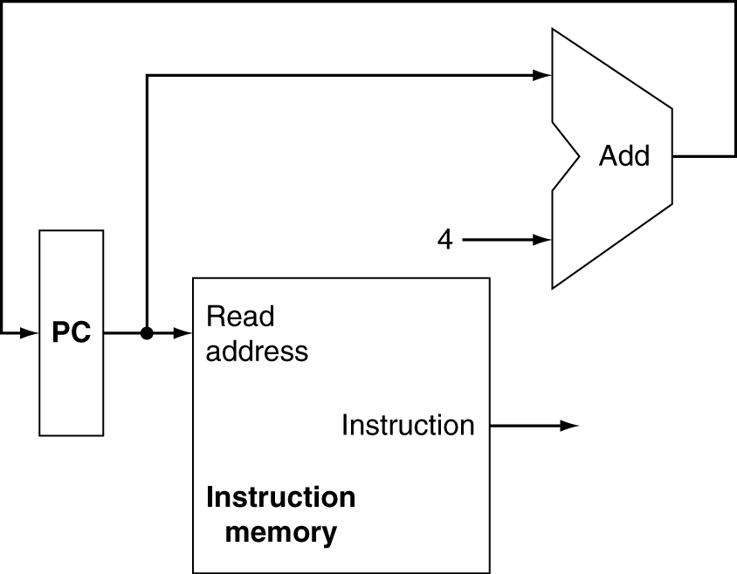
Instruction Fetch
Increment by 4 for next instruction
32-bit register

Slide 14
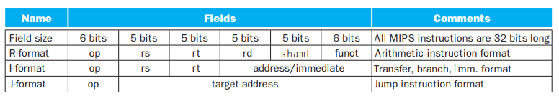
Recall: Instruction Formats

Slide 15
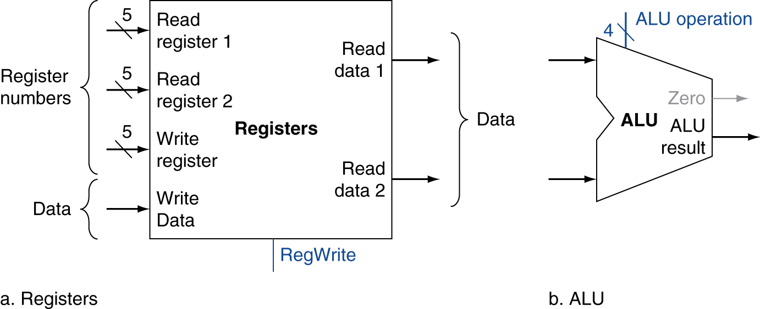
R-Format Instructions
Read two register operands
Perform arithmetic/logical operation
Write register result
6 bits | 5 bits | 5 bits | 5 bits | 5 bits | 6 bits
op | rs | rt | rd | shamt | funct

Slide 16
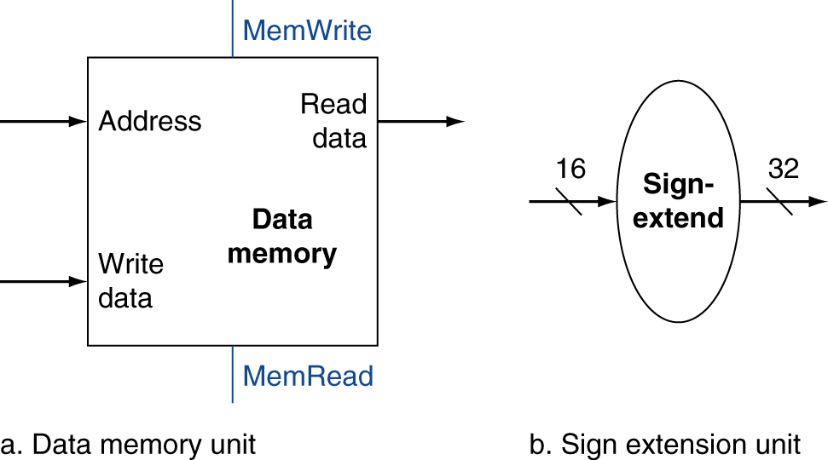
Load/Store Instructions
Read register operands
Calculate address using 16-bit offset
Use ALU, but sign-extend offset
Load: Read memory and update register
Store: Write register value to memory
6 bits | 5 bits | 5 bits | 5+5+6 = 16 bits
op | rs | rt | addr./imm.

Slide 17
Load/Store Instructions
Read register operands
Calculate address using 16-bit offset
Use ALU, but sign-extend offset
Load: Read memory and update register
Store: Write register value to memory
Store
Load
6 bits | 5 bits | 5 bits | 5+5+6 = 16 bits
op | rs | rt | addr./imm.

Slide 18
Branch Instructions
Read register operands
Compare operands
Use ALU, subtract and check Zero output
Calculate target address
Sign-extend displacement
Shift left 2 places (word displacement)
Add to PC + 4
Already calculated by instruction fetch

Slide 19
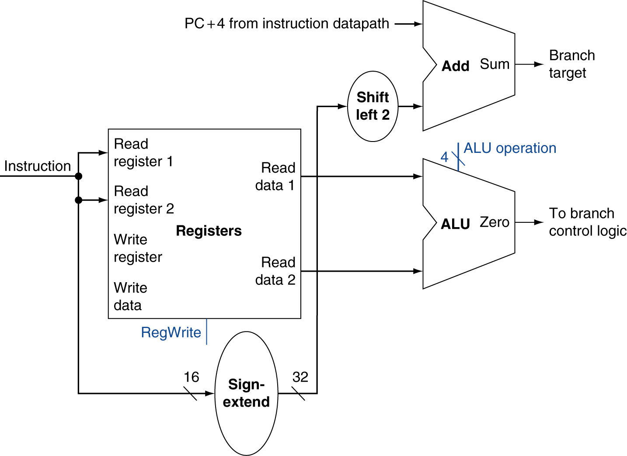
Branch Instructions
Just re-routes wires
Sign-bit wire replicated

Slide 20
Composing the Elements
First-cut data path does an instruction in one clock cycle
Each datapath element can only do one function at a time
Hence, we need separate instruction and data memories
Use multiplexers where alternate data sources are used for different instructions

Slide 21
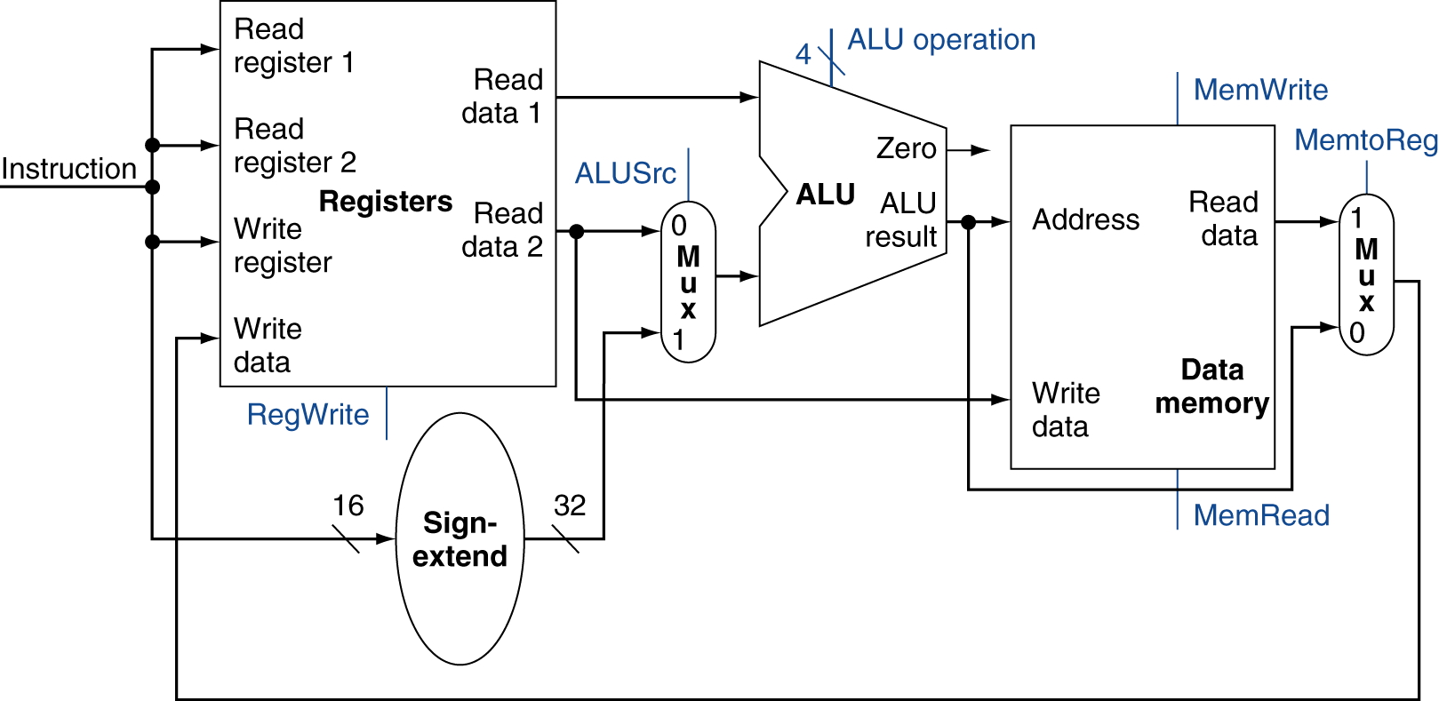
R-Type/Load/Store Datapath

Slide 22
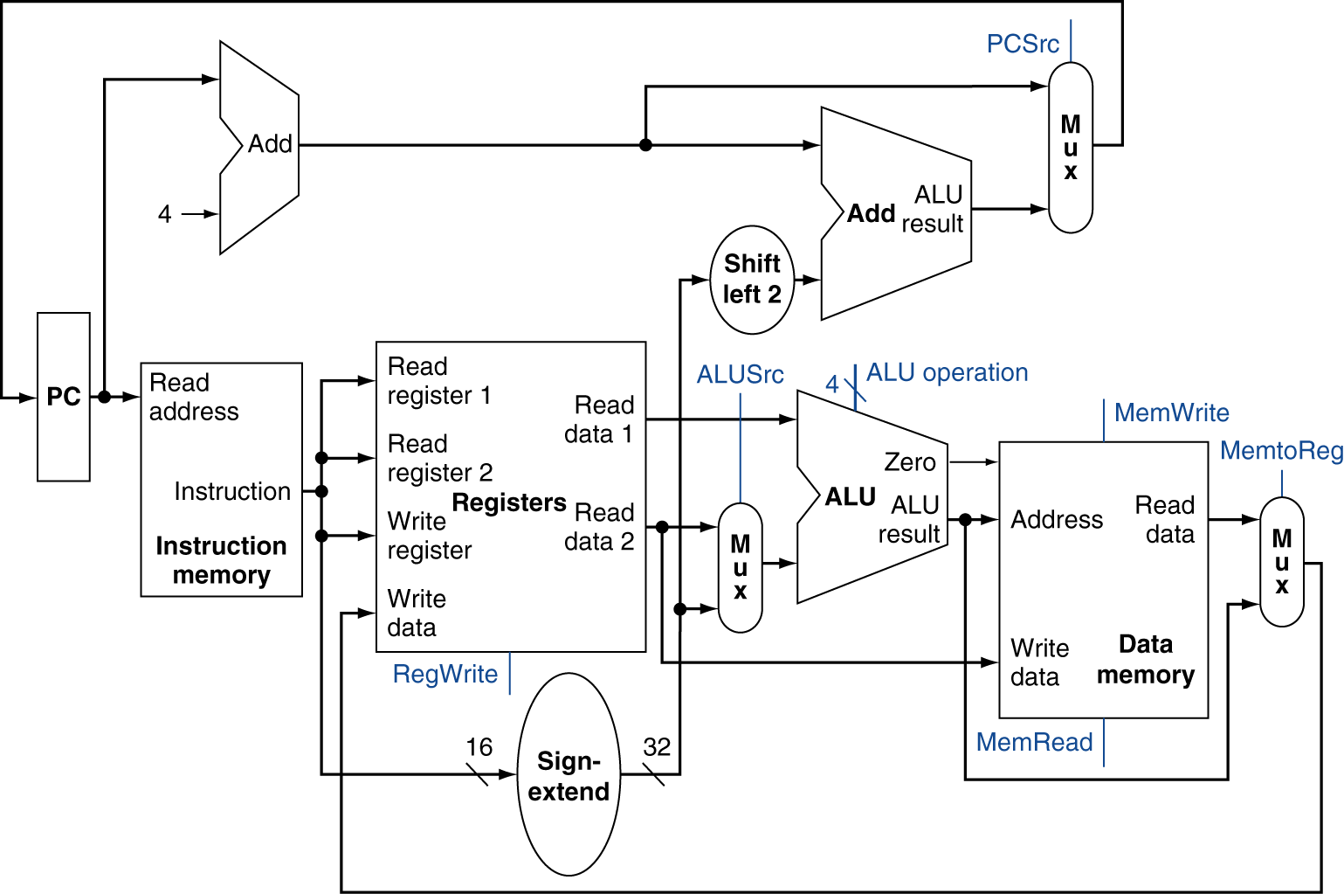
Full Datapath

Slide 23
ALU Control
ALU used for
Load/Store: F = add
Branch: F = subtract
R-type: F depends on funct field
§4.4 A Simple Implementation Scheme
ALU control | Function
0000 | AND
0001 | OR
0010 | add
0110 | subtract
0111 | set-on-less-than
1100 | NOR

Slide 24
ALU Control
Assume 2-bit ALUOp derived from opcode
Combinational logic derives ALU control
opcode | ALUOp | Operation | funct | ALU function | ALU control
lw | 00 | load word | XXXXXX | add | 0010
sw | 00 | store word | XXXXXX | add | 0010
beq | 01 | branch equal | XXXXXX | subtract | 0110
R-type | 10 | add | 100000 | add | 0010
 |  | subtract | 100010 | subtract | 0110
 |  | AND | 100100 | AND | 0000
 |  | OR | 100101 | OR | 0001
 |  | set-on-less-than | 101010 | set-on-less-than | 0111

Slide 25
The Main Control Unit
Control signals derived from instruction
R-type
0
rs
rt
rd
shamt
funct
31:26
25:21
20:16
15:11
10:6
5:0
Load/ Store
35 or 43
rs
rt
address
31:26
25:21
20:16
15:0
Branch
4
rs
rt
address
31:26
25:21
20:16
15:0
opcode
always read
read, except for load
write for R-type and load
sign-extend and add

Slide 26
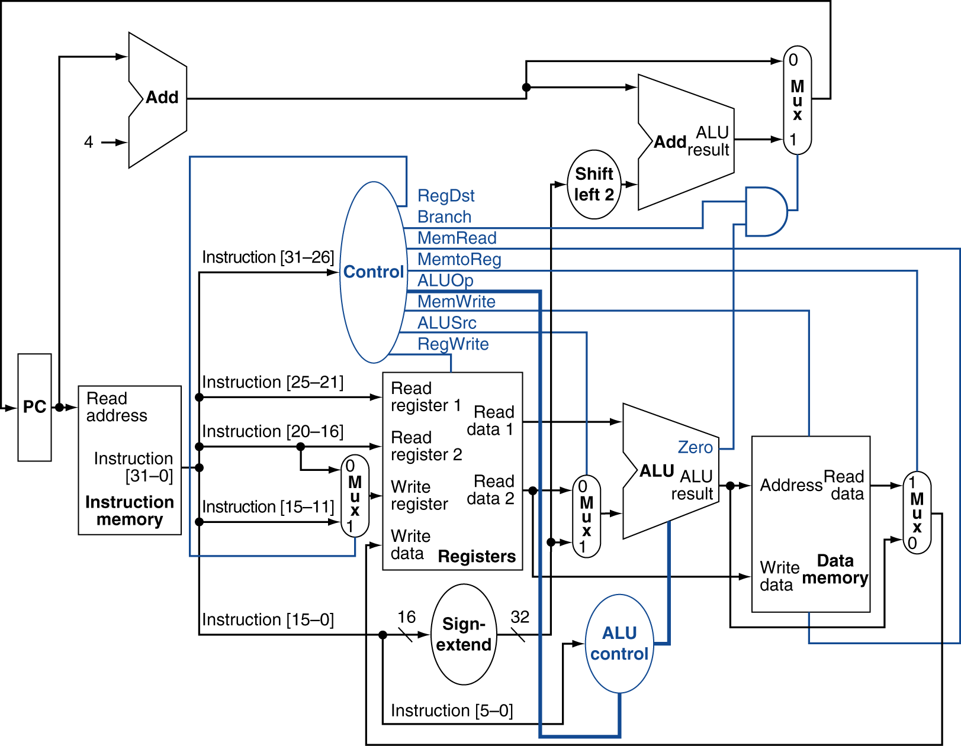
Datapath With Control

Slide 27
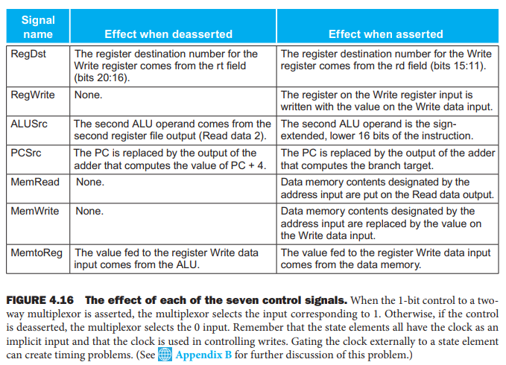
All Control Signals

Slide 28
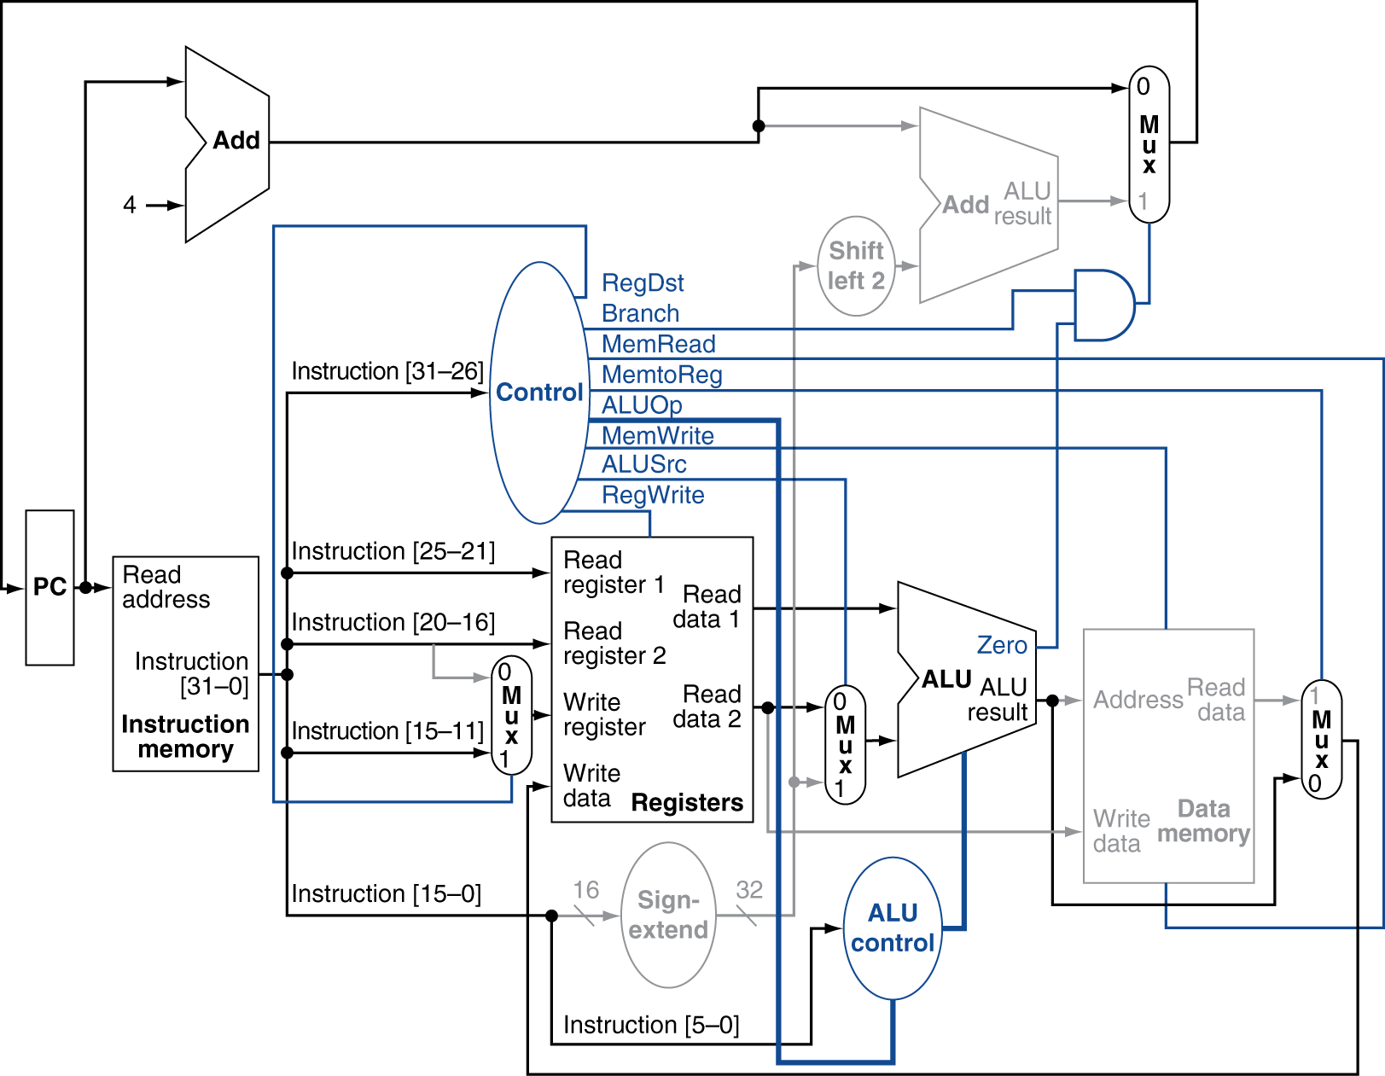
R-Type Instruction

Slide 29
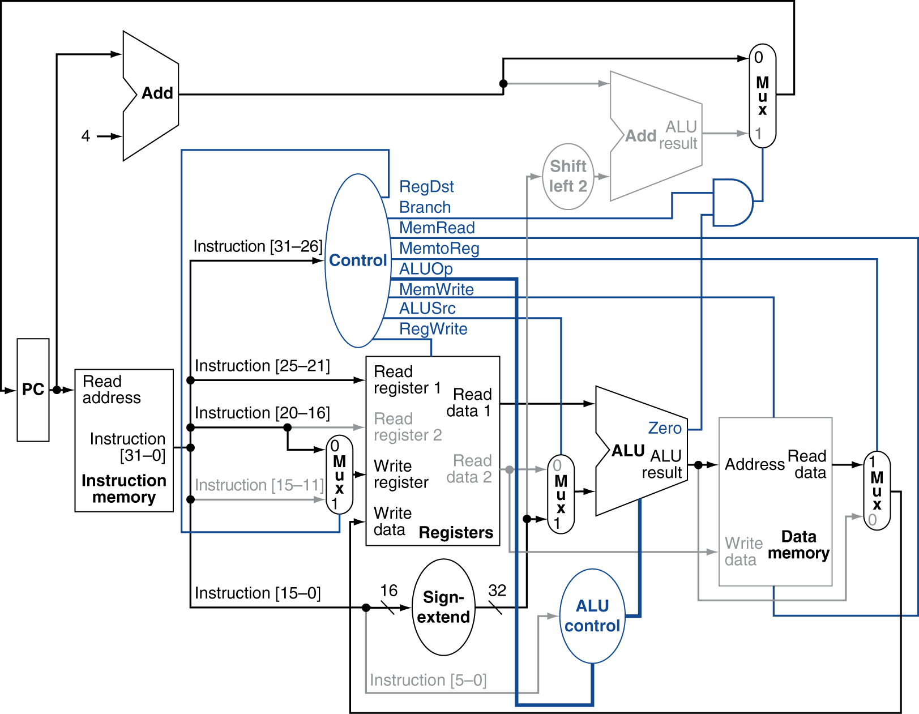
Load Instruction

Slide 30
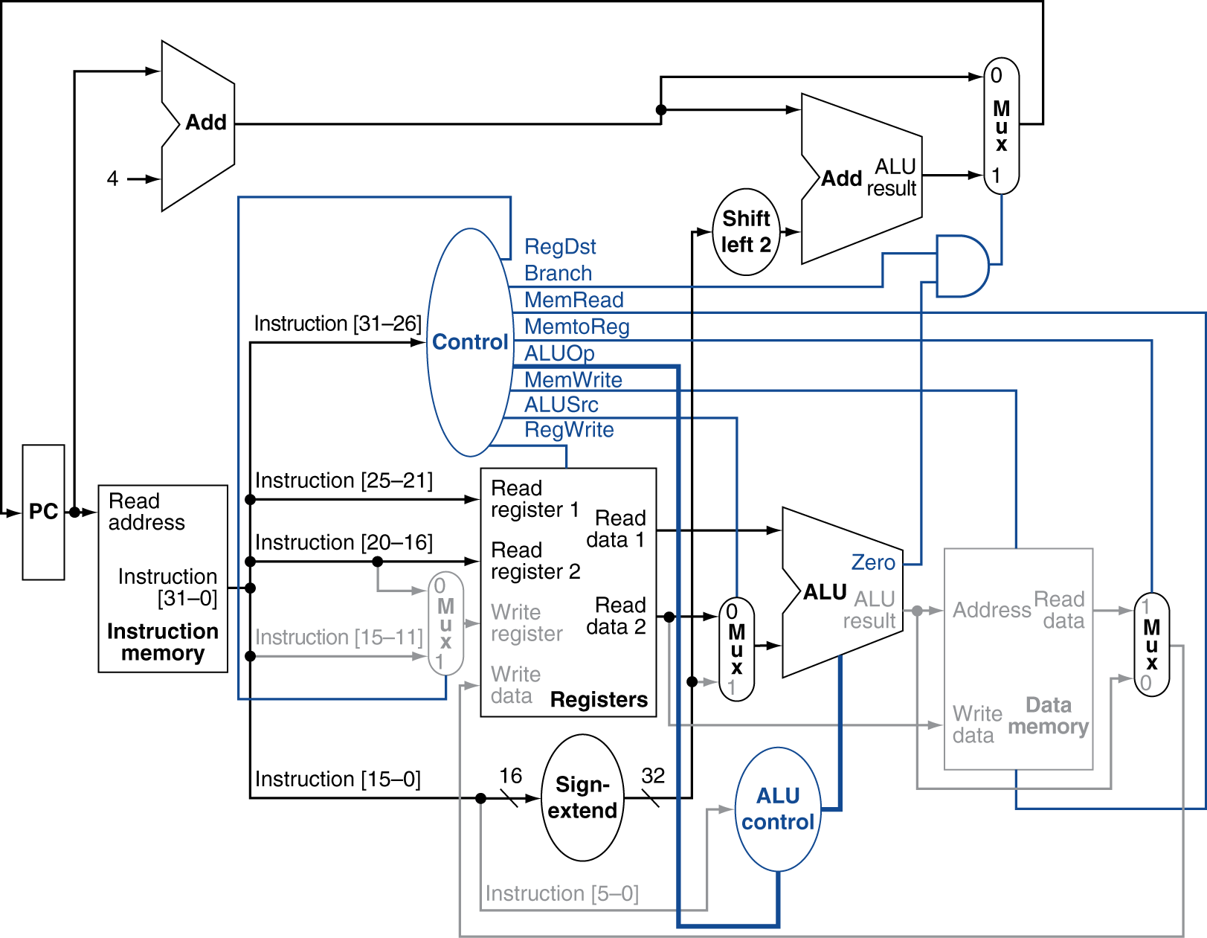
Branch-on-Equal Instruction

Slide 31
Implementing Jumps
Jump
2
address
31:26
25:0
Jump uses word address
Update PC with concatenation of
Top 4 bits of old PC
26-bit jump address
00
Need an extra control signal decoded from opcode

Slide 32
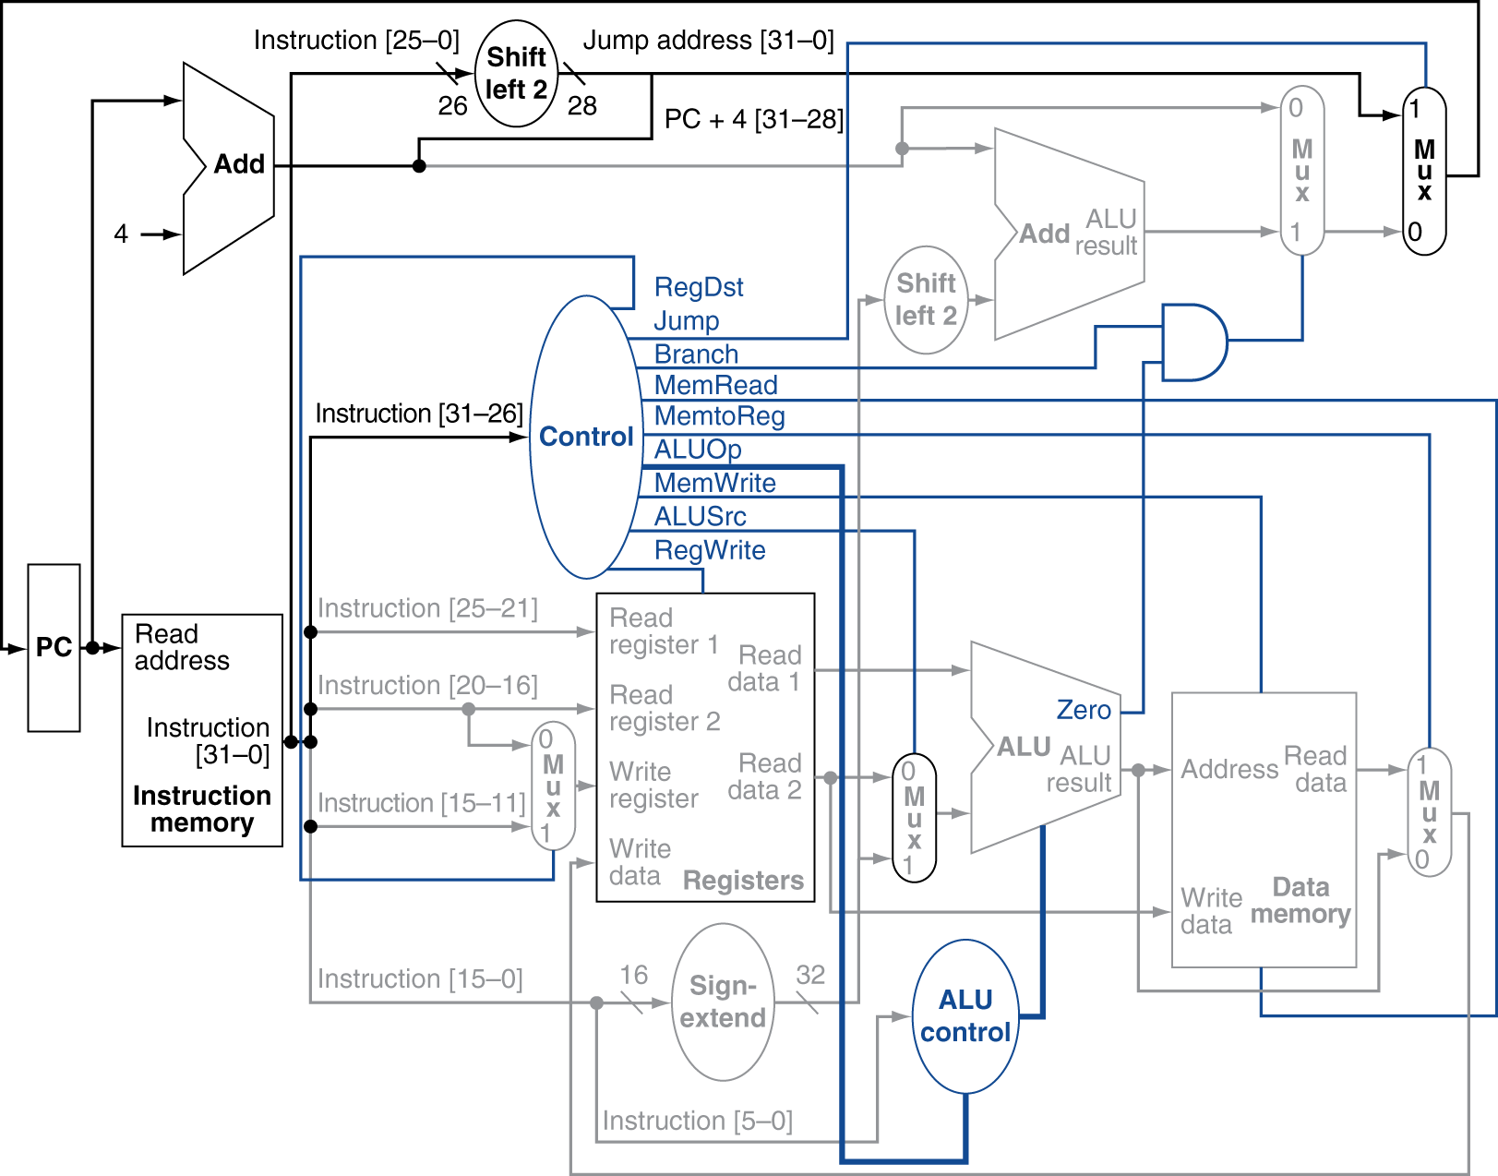
Datapath With Jumps Added

Slide 33
Performance Issues
Longest delay determines clock period
Critical path: load instruction
Instruction memory → register file → ALU → data memory → register file
Not feasible to vary period for different instructions
Violates design principle
Making the common case fast
We will improve performance by pipelining

Slide 34
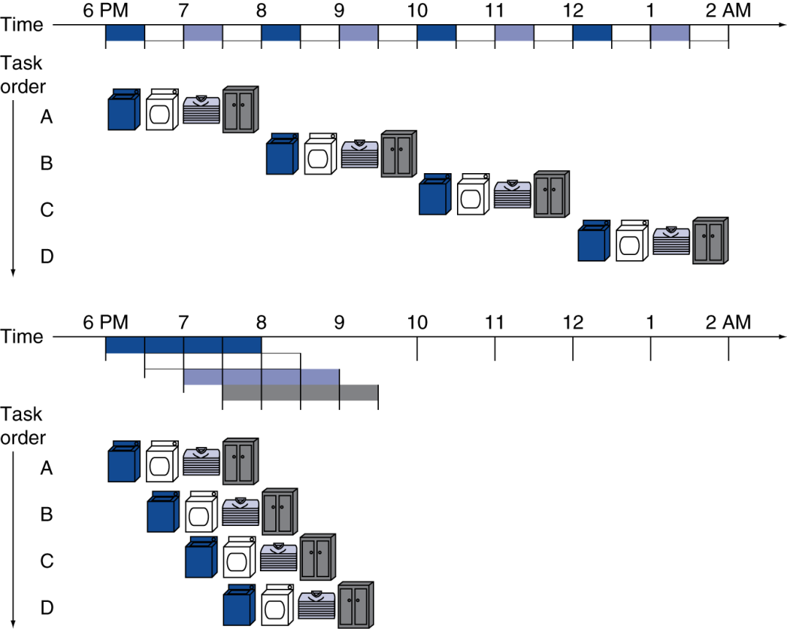
Pipelining Analogy
Pipelined laundry: overlapping execution
Parallelism improves performance
§4.5 An Overview of Pipelining
2 hours
1.5 hours
0.5 hour

Slide 35
MIPS Pipeline
Five stages, one step per stage
IF: Instruction fetch from memory
ID: Instruction decode & register read
EX: Execute operation or calculate address
MEM: Access memory operand
WB: Write result back to register

Slide 36
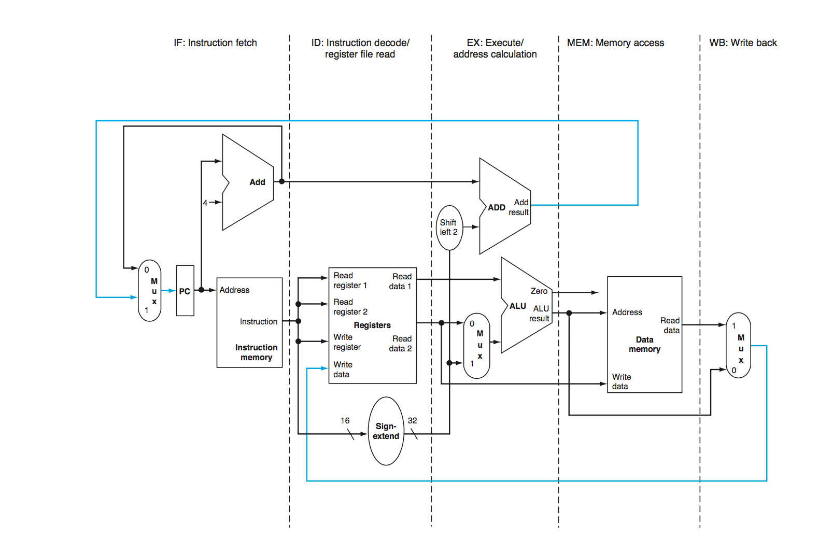
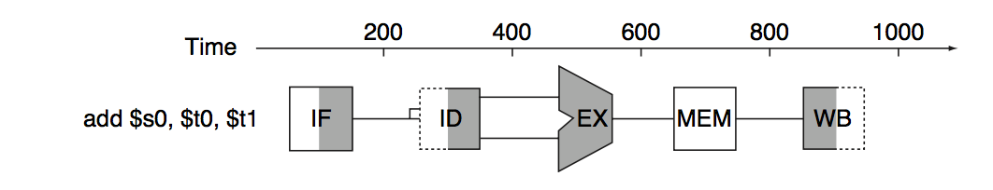
MIPS Stages

Slide 37
Pipeline Performance
Assume time for stages is
100ps for register read or write
200ps for other stages
Compare pipelined datapath with single-cycle datapath
Instr | Instr fetch | Register read | ALU op | Memory access | Register write | Total time
lw | 200ps | 100 ps | 200ps | 200ps | 100 ps | 800ps
sw | 200ps | 100 ps | 200ps | 200ps |  | 700ps
R-format | 200ps | 100 ps | 200ps |  | 100 ps | 600ps
beq | 200ps | 100 ps | 200ps |  |  | 500ps

Slide 38
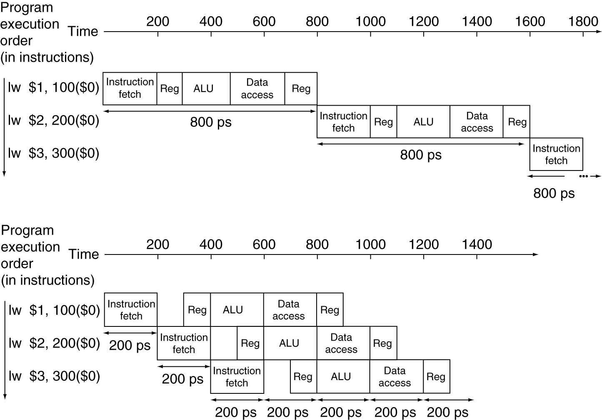
Pipeline Performance
Single-cycle (T_{c}= 800ps)
T_{c} = Time between instructions
Pipelined (T_{c}= 200ps)

Slide 39
Pipeline Speedup
If all stages are balanced
i.e., all take the same time
Time between instructions_{pipelined} = Time between instructions_{nonpipelined} Number of stages
If not balanced, speedup is less
Speedup due to increased throughput
Latency (time for each instruction) does not decrease

Slide 40
Hazards
Situations that prevent starting the next instruction in the next cycle
Structure hazards
A required resource is busy
Data hazard
Need to wait for previous instruction to complete its data read/write
Control hazard
Deciding on control action depends on previous instruction

Slide 41
Structure Hazards
Conflict for use of a resource
In MIPS pipeline with a single memory
Load/store requires data access
Instruction fetch would have to stall for that cycle
Would cause a pipeline “bubble”
Hence, pipelined datapaths require separate instruction/data memories
Or separate instruction/data caches

Slide 42
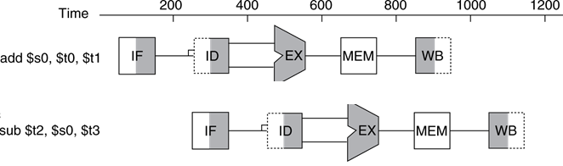
Data Hazards
An instruction depends on completion of data access by a previous instruction
add $s0, $t0, $t1 sub $t2, $s0, $t3
$s0 written here!!!
$s0 needed here!!!

Slide 43
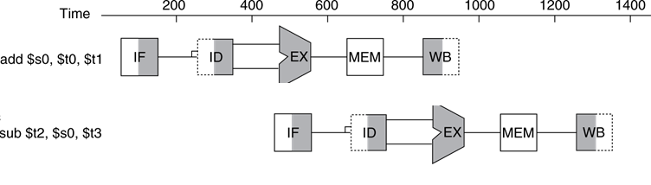
Data Hazards
An instruction depends on completion of data access by a previous instruction
add $s0, $t0, $t1 sub $t2, $s0, $t3
$s0 written here!!!
$s0 needed here!!!

Slide 44
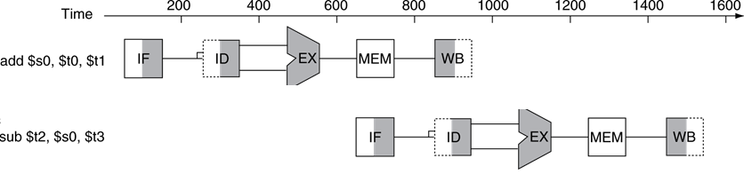
Data Hazards
An instruction depends on completion of data access by a previous instruction
add $s0, $t0, $t1 sub $t2, $s0, $t3
$s0 written here!!!
$s0 needed here!!!

Slide 45
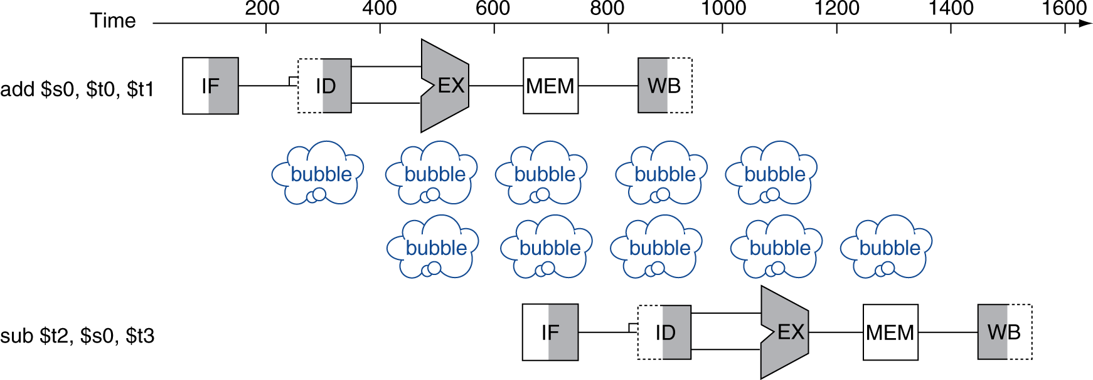
Data Hazards
An instruction depends on completion of data access by a previous instruction
add $s0, $t0, $t1 sub $t2, $s0, $t3

Slide 46
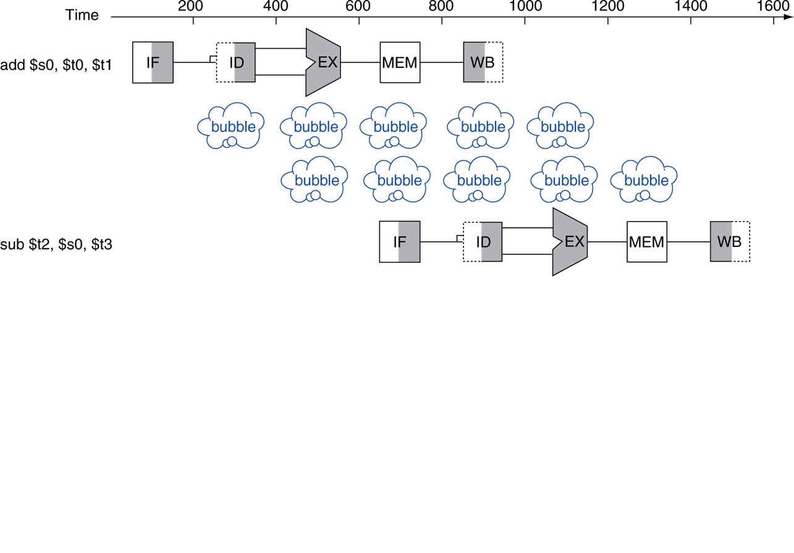
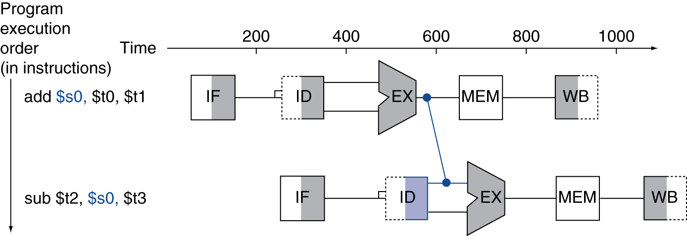
Forwarding (aka Bypassing)
Use result when it is computed
Don’t wait for it to be stored in a register
Requires extra connections in the datapath
C O M P A R E
$s0 ready here!!!
$s0 written here!!!
$s0 needed here!!!

Slide 47
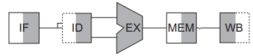
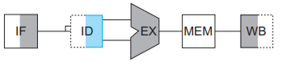
Load-Use Data Hazard
Can’t always avoid stalls by forwarding
If value not computed when needed
Can’t forward backward in time!
$s0 written here!!!
$s0 needed here!!!

Slide 48


Load-Use Data Hazard
Can’t always avoid stalls by forwarding
If value not computed when needed
Can’t forward backward in time!
When WAS the data Ready for R-type?
Can we solve by
FORWARDING?
When is the data Ready?
$s0 written here!!!
$s0 needed here!!!

Slide 49

Load-Use Data Hazard
Can’t always avoid stalls by forwarding
If value not computed when needed
Can’t forward backward in time!
Can we solve by
FORWARDING?
When is the data Ready?
When WAS the data Ready for R-type?
$s0 written here!!!
$s0 needed here!!!
Time Travel!!!

Slide 50
Load-Use Data Hazard
Can’t always avoid stalls by forwarding
If value not computed when needed
Can’t forward backward in time!
Can we solve by
FORWARDING?
When is the data Ready?
$s0 written here!!!
$s0 needed here!!!

Slide 51
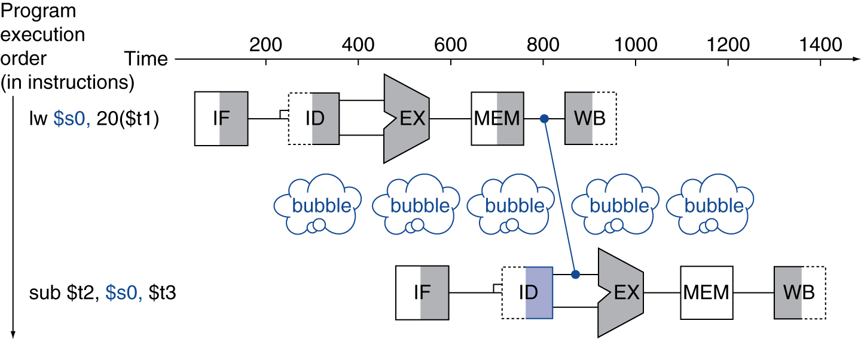
Load-Use Data Hazard
Can’t always avoid stalls by forwarding
If value not computed when needed
Can’t forward backward in time!

Slide 52
Code Scheduling to Avoid Stalls
Reorder code to avoid use of load result in the next instruction
C code for A = B + E; C = B + F;
lw $t1, 0($t0)
lw $t2, 4($t0)
add $t3, $t1, $t2
sw $t3, 12($t0)
lw $t4, 8($t0)
add $t5, $t1, $t4
sw $t5, 16($t0)
lw $t1, 0($t0)
lw $t2, 4($t0)
lw $t4, 8($t0)
add $t3, $t1, $t2
sw $t3, 12($t0)
add $t5, $t1, $t4
sw $t5, 16($t0)
stall
stall
13 cycles
11 cycles

Slide 53
1 | 2 | 3 | 4 | 5 | 6 | 7 | 8 | 9 | 10 | 11 | 12 | 13
lw $t1, 0($t0)
lw $t2, 4($t0)
add $t3, $t1, $t2
sw $t3, 12($t0)
lw $t4, 8($t0)
add $t5, $t1, $t4
sw $t5, 16($t0)
stall
stall
13 cycles

Slide 54
1 | 2 | 3 | 4 | 5 | 6 | 7 | 8 | 9 | 10 | 11 | 12 | 13
lw $t1, 0($t0)
lw $t2, 4($t0)
lw $t4, 8($t0)
add $t3, $t1, $t2
sw $t3, 12($t0)
add $t5, $t1, $t4
sw $t5, 16($t0)
lw $t1, 0($t0)
lw $t2, 4($t0)
add $t3, $t1, $t2
sw $t3, 12($t0)
lw $t4, 8($t0)
add $t5, $t1, $t4
sw $t5, 16($t0)
11 cycles

Slide 55
Control Hazards
Branch determines flow of control
Fetching next instruction depends on branch outcome
Pipeline can’t always fetch correct instruction
Still working on ID stage of branch
In MIPS pipeline
Need to compare registers and compute target early in the pipeline
Add hardware to do it in ID stage

Slide 56
Branch Scenario
When is the branch decision made?
Branch Taken

Slide 57
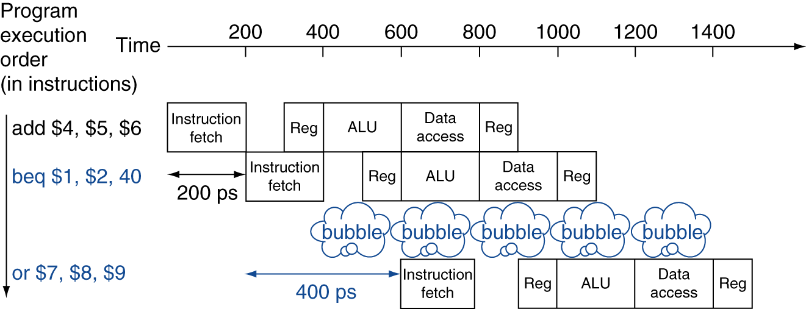
Stall on Branch (Improved)
Assume enough extra hardware to test registers, calculate the branch address, and update the PC during the second stage (ID stage)

Slide 58
Branch Prediction
Longer pipelines can’t readily determine branch outcome early
Stall penalty becomes unacceptable
Predict outcome of branch
Only stall if prediction is wrong
In MIPS pipeline
Can predict branches not taken
Fetch instruction after branch, with no delay

Slide 59
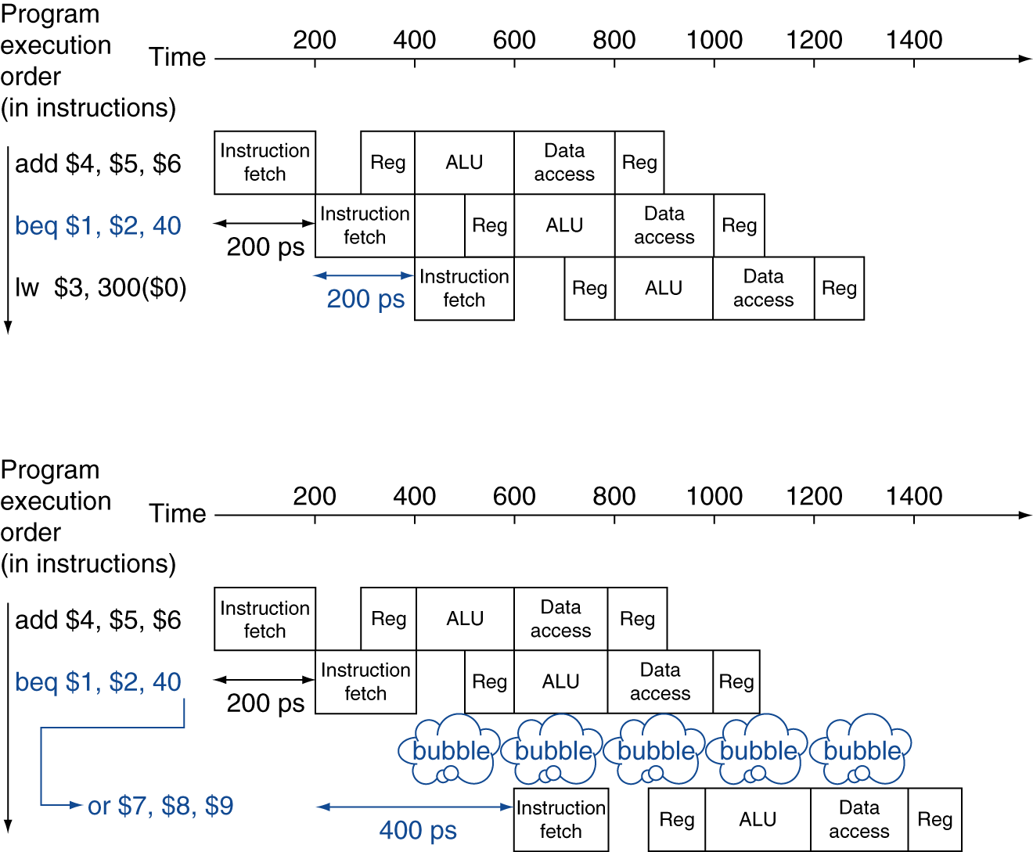
MIPS with Predict Not Taken
Prediction correct
Prediction incorrect

Slide 60
More-Realistic Branch Prediction
Static branch prediction
Based on typical branch behavior
Example: loop and if-statement branches
Predict backward branches taken
Predict forward branches not taken
Dynamic branch prediction
Hardware measures actual branch behavior
e.g., record recent history of each branch
Assume future behavior will continue the trend
When wrong, stall while re-fetching, and update history

Slide 61
Delayed Branch
Always execute the next sequential instruction
i.e., taken branch is always delayed
The delay is hidden by rearrangement
MIPS Solution to Control Hazard
Branch Taken

Slide 62
Pipeline Summary
The BIG Picture
Pipelining improves performance by increasing instruction throughput
Executes multiple instructions in parallel
Each instruction has the same latency
Subject to hazards
Structure, data, control
Instruction set design affects complexity of pipeline implementation

Slide 63
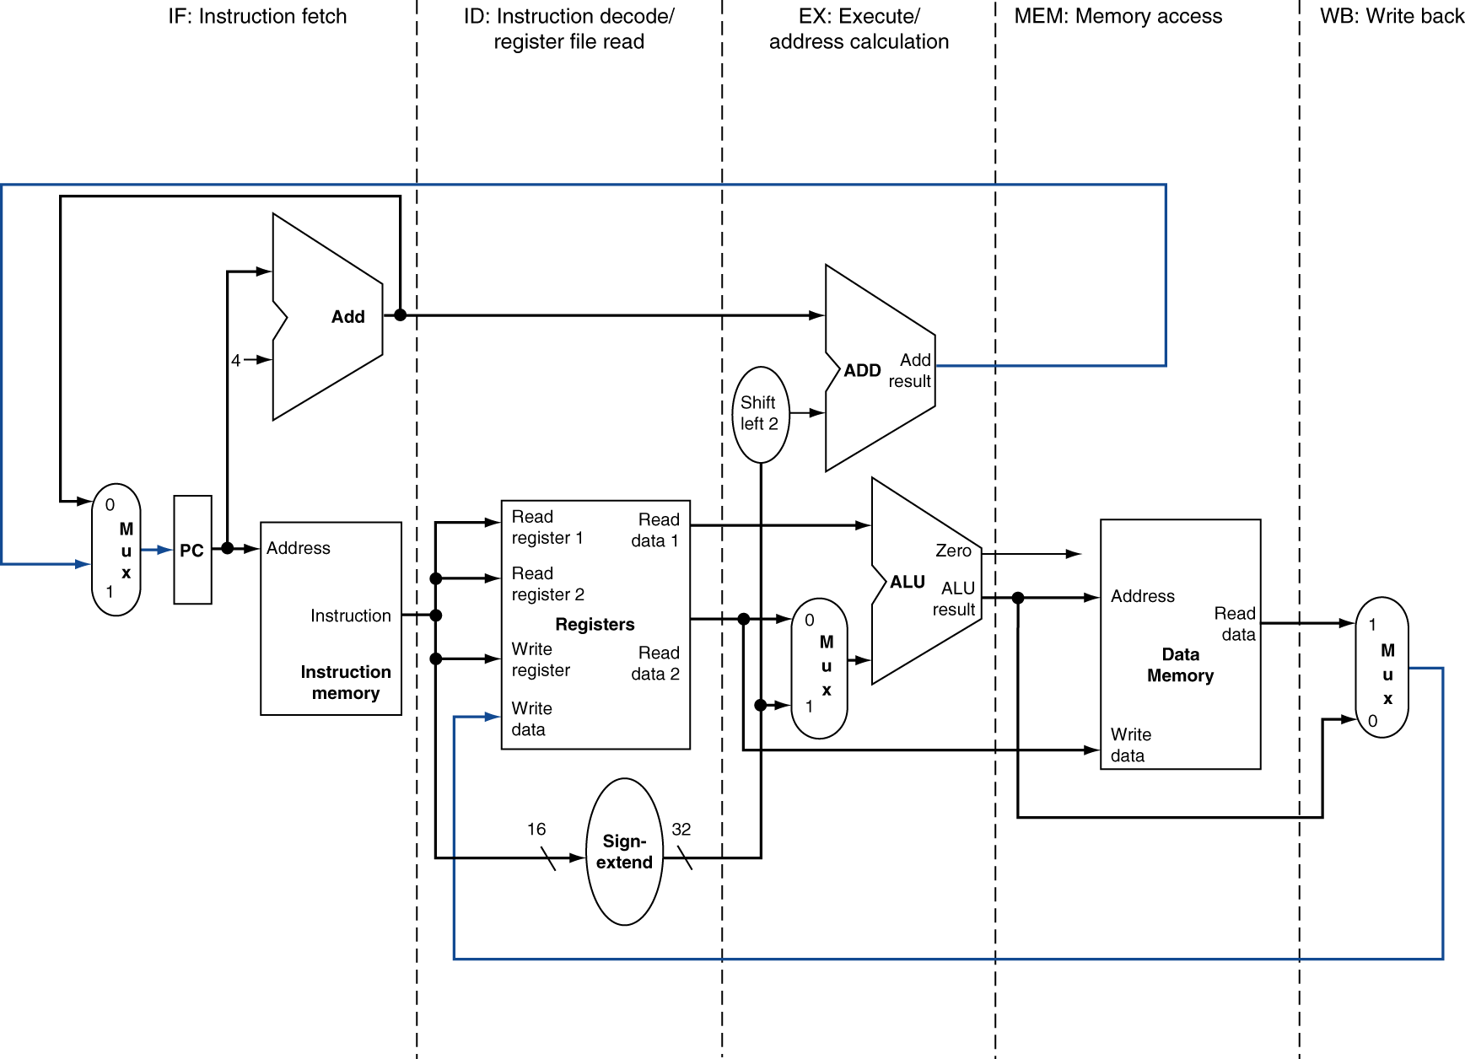
MIPS Pipelined Datapath
Source for
Control Hazard
§4.6 Pipelined Datapath and Control
MEM
Right-to-left flow leads to hazards
WB
Source for
data Hazard

Slide 64
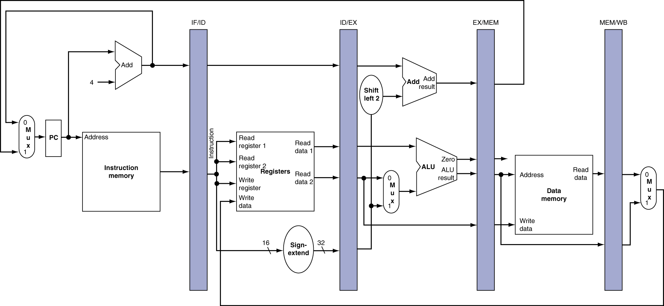
Pipeline registers
We may need to update the sizes as we proceed!!!
Need registers between stages
To hold information produced in previous cycle
32+32 = 64
32x4 = 128
32x3 + 1 = 97
32 +32 = 64
32
32
32
32
01
32
32
32
32
32
32
32
What is the size of the pipeline registers?

Slide 65
Pipeline Operation
Cycle-by-cycle flow of instructions through the pipelined datapath
“Single-clock-cycle” pipeline diagram
Shows pipeline usage in a single cycle
Highlight resources used
c.f. “multi-clock-cycle” diagram
Graph of operation over time
We’ll look at “single-clock-cycle” diagrams for load & store

Slide 66
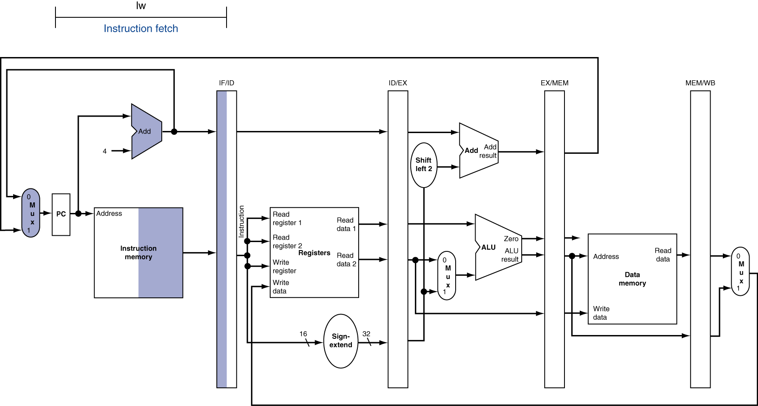
IF for Load

Slide 67
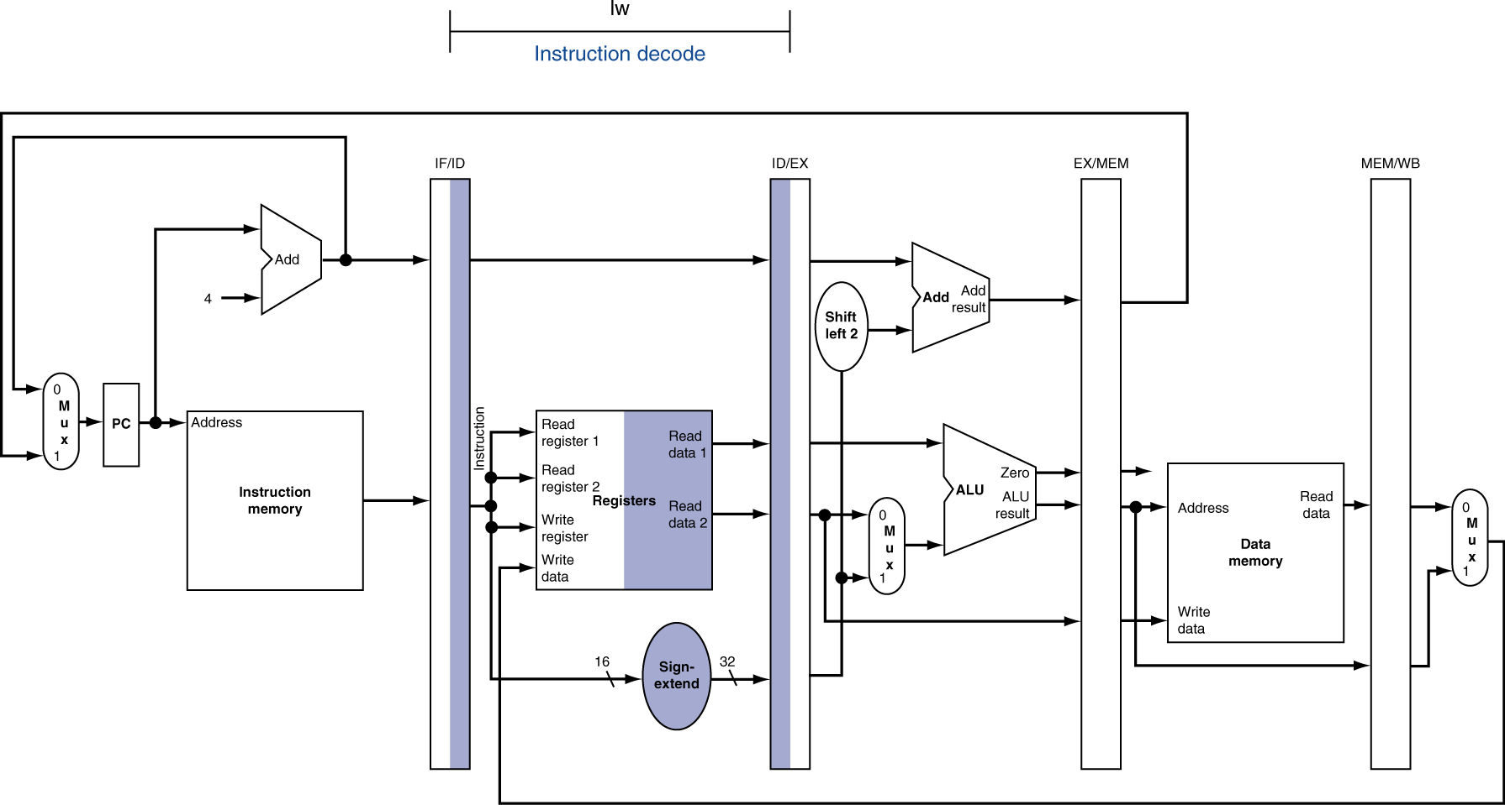
ID for Load

Slide 68
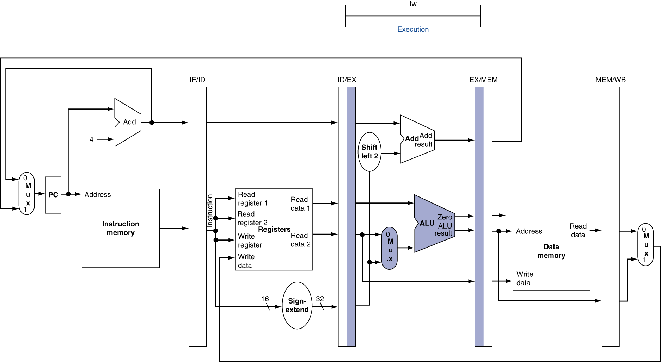
EX for Load

Slide 69
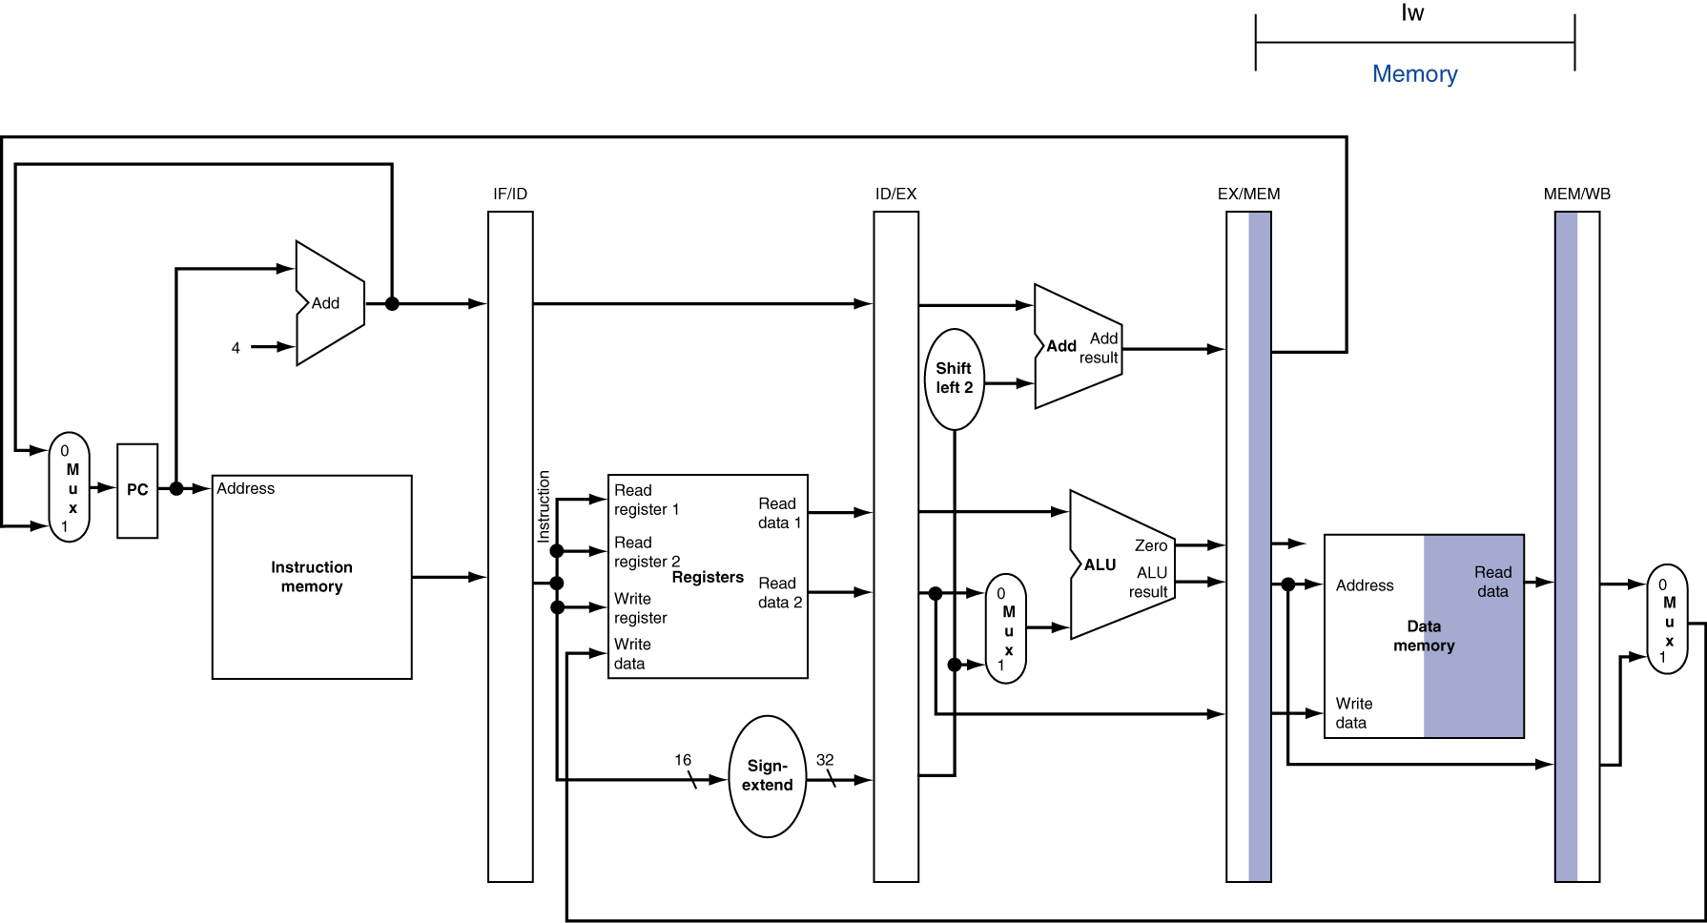
MEM for Load

Slide 70
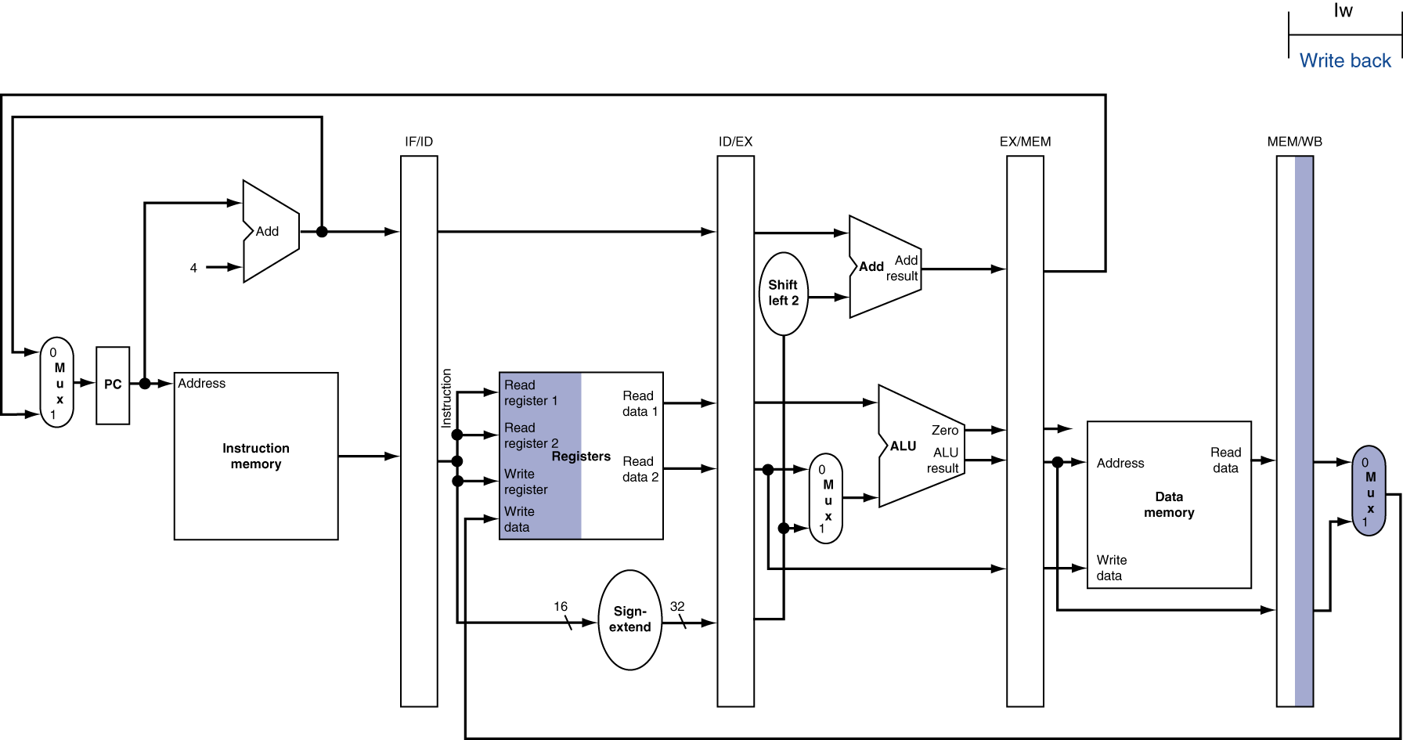
WB for Load

Slide 71
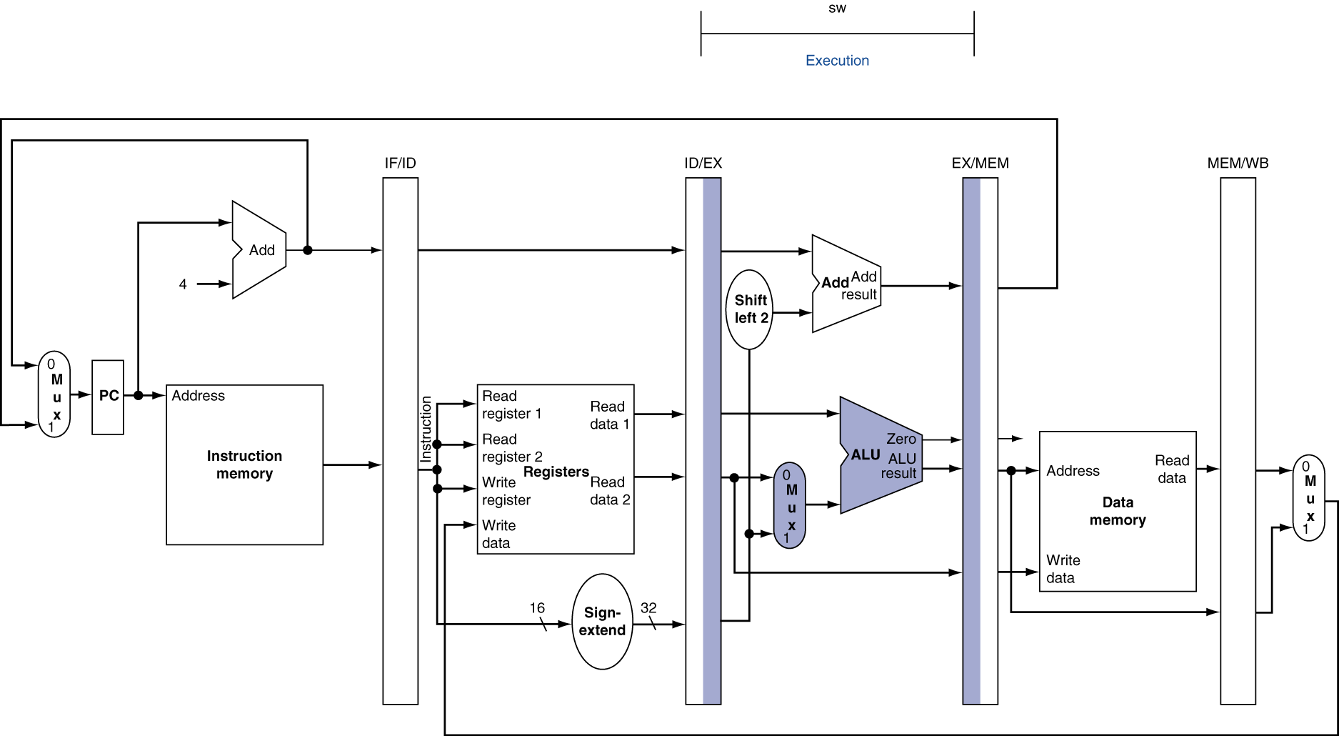
EX for Store

Slide 72
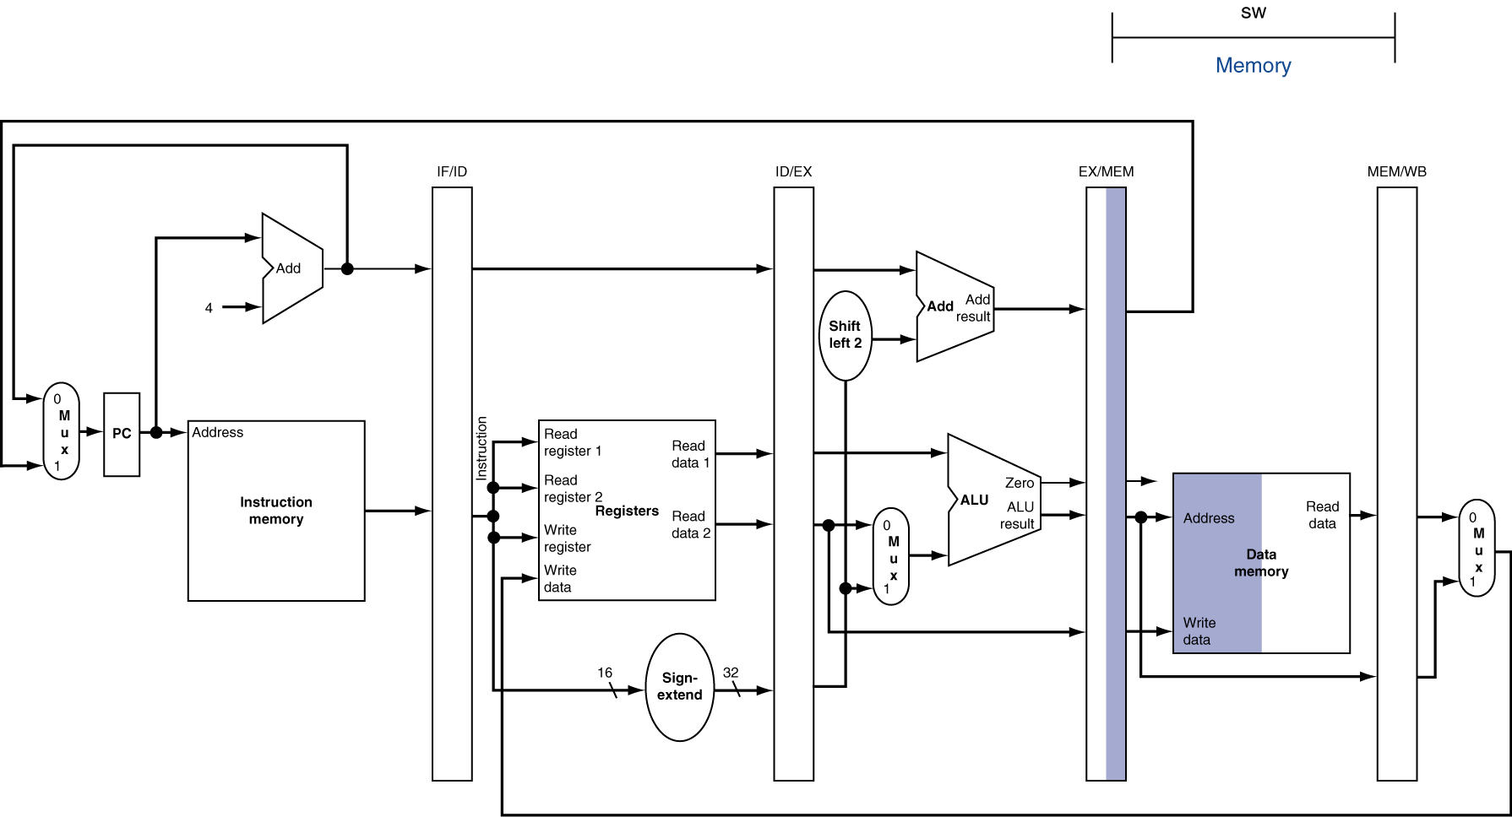
MEM for Store

Slide 73
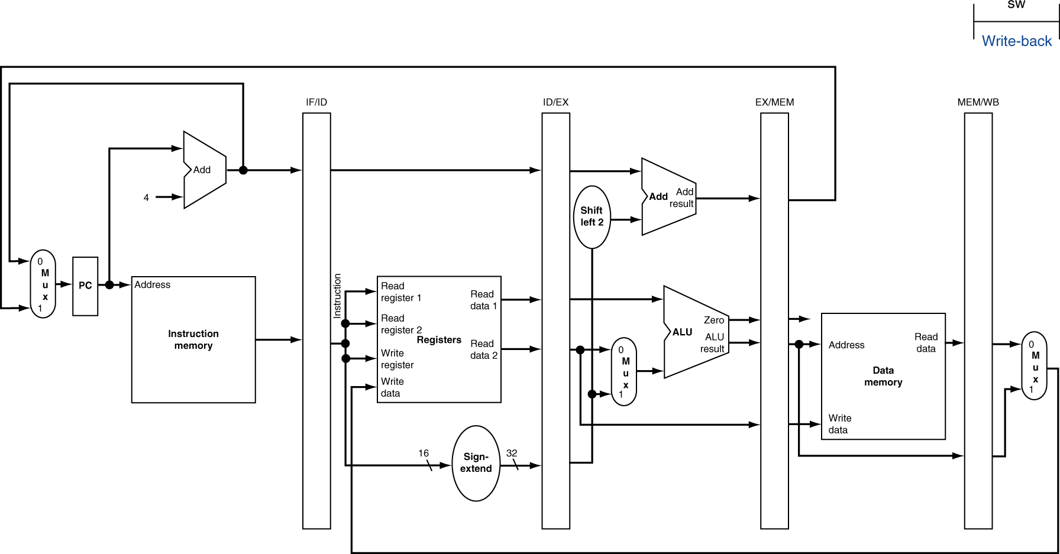
WB for Store

Slide 74
WB for Load Revisited
Wrong register number

Slide 75
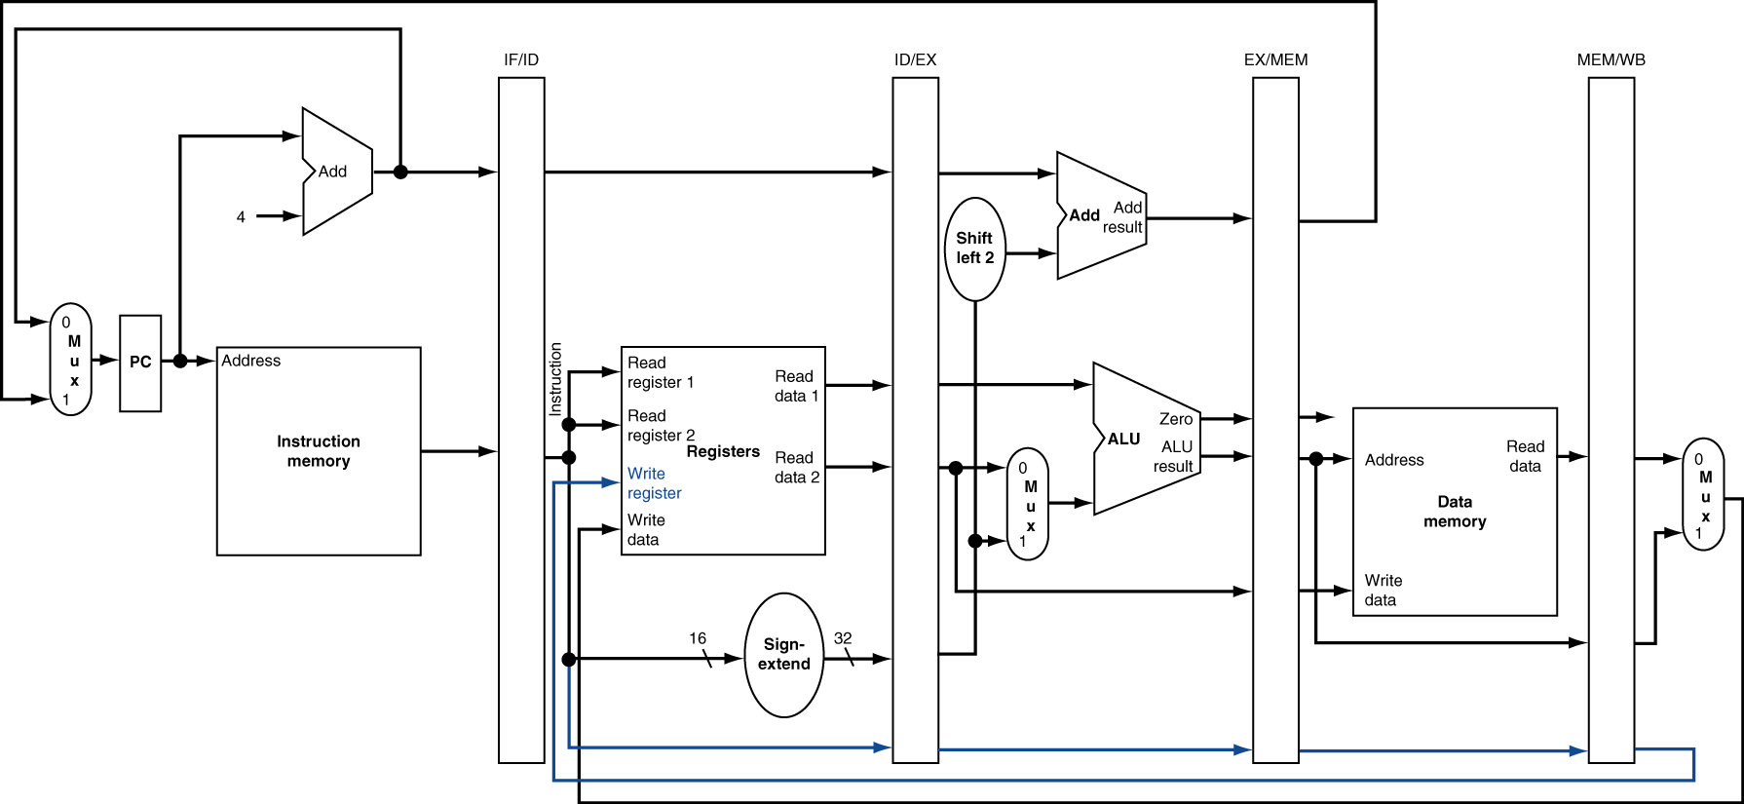
Corrected Datapath for Load

Slide 76
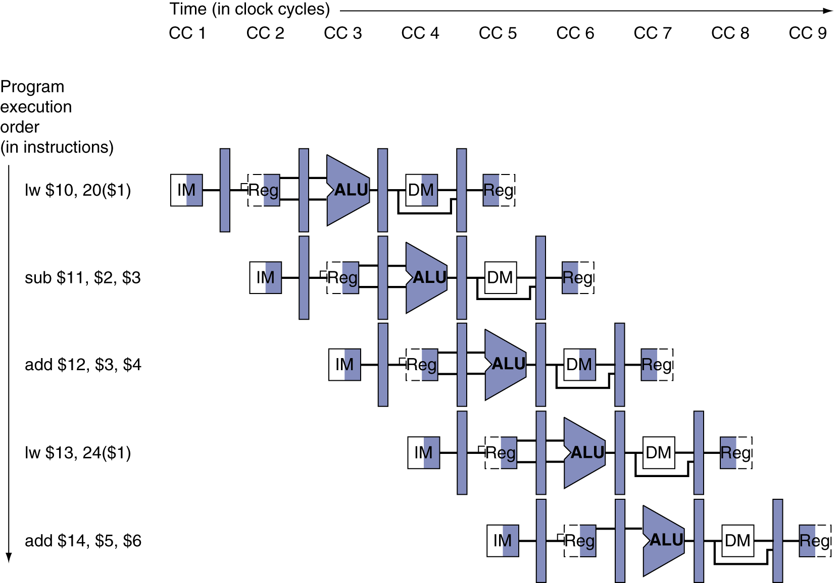
Multi-Cycle Pipeline Diagram
Form showing resource usage

Slide 77
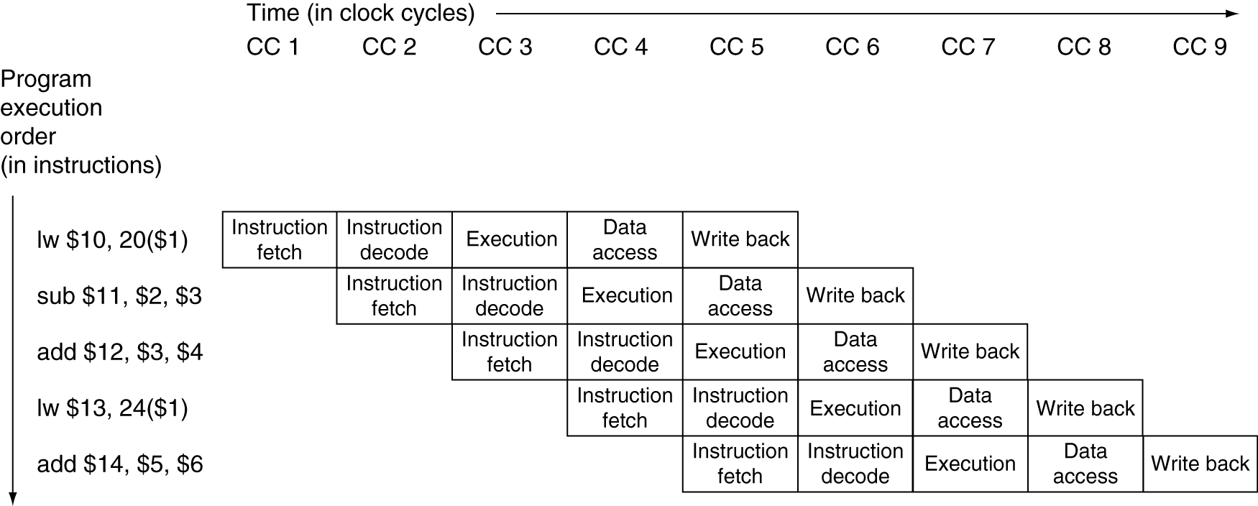
Multi-Cycle Pipeline Diagram
Traditional form

Slide 78
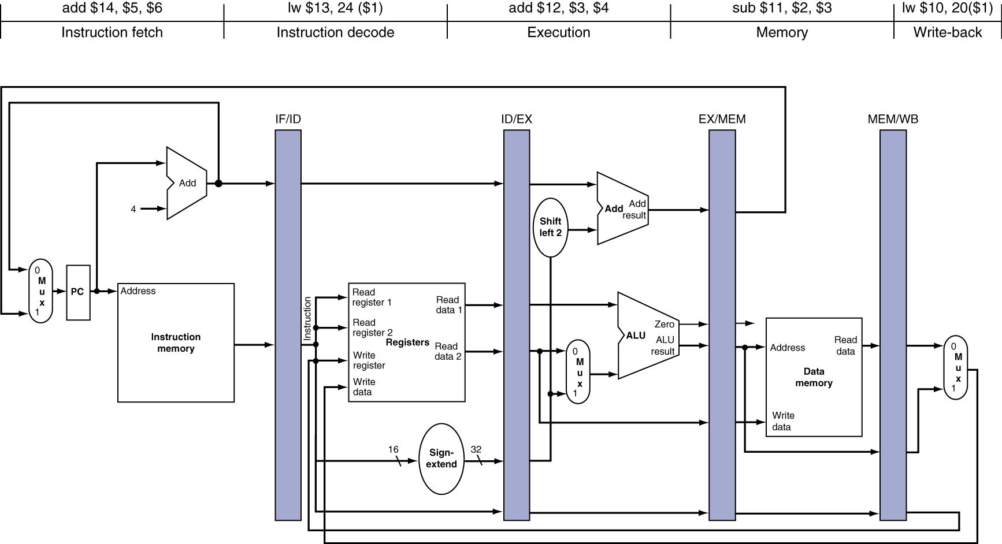
Single-Cycle Pipeline Diagram
State of pipeline in a given cycle

Slide 79
Single-Cycle Pipeline Diagram
State of pipeline in a given cycle

Slide 80
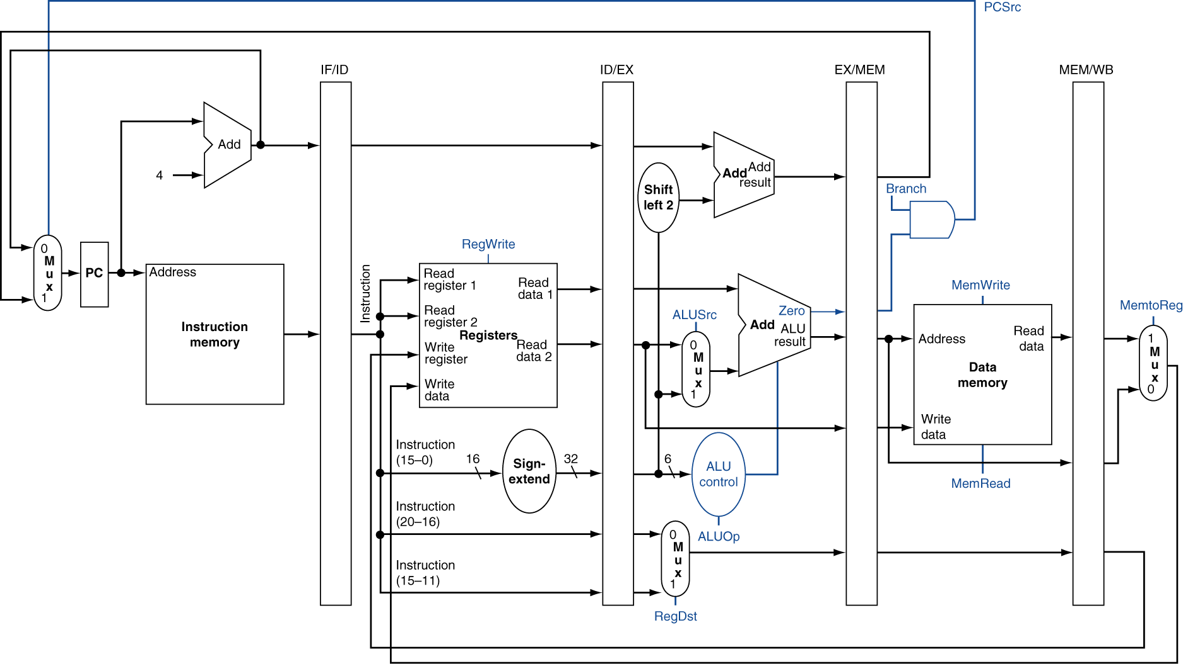
Pipelined Control (Simplified)
ID: No Special Control Needed
MEM Stage
WB
Stage
Confusing!!!
RegWrite is actually at WB stage
IF: No Special Control Needed
EXE Stage

Slide 81
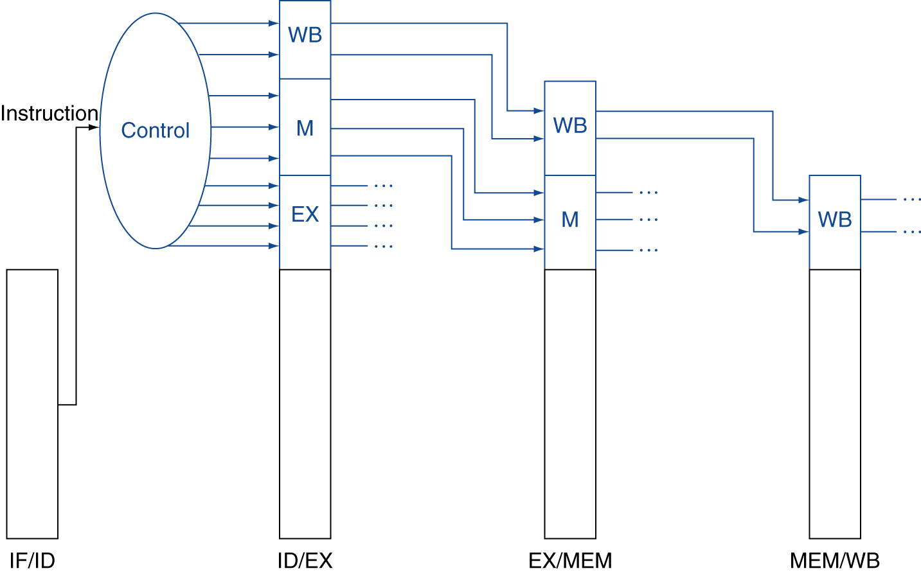
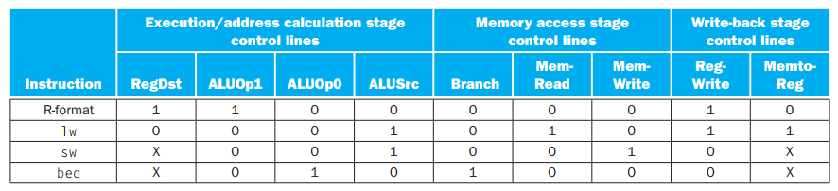
Pipelined Control
Control signals derived from instruction
As in single-cycle implementation

Slide 82
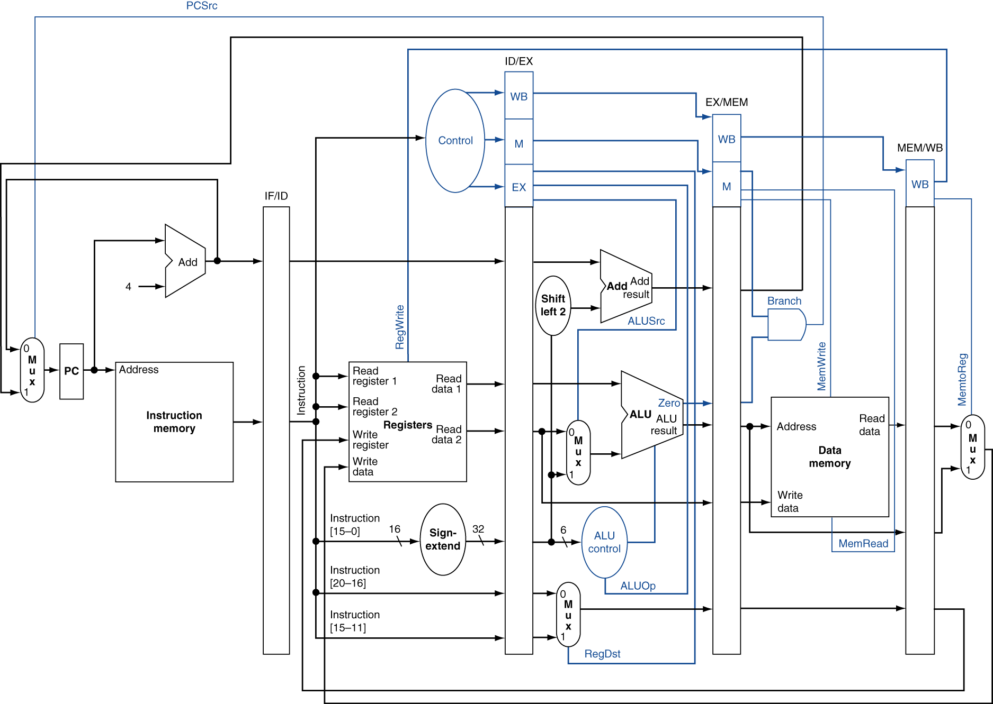
Pipelined Control

Slide 83
Data Hazards in ALU Instructions
Consider this sequence:
sub $2, $1,$3 and $12,$2,$5 or $13,$6,$2 add $14,$2,$2 sw $15,100($2)
We can resolve hazards with forwarding
How do we detect when to forward?
§4.7 Data Hazards: Forwarding vs. Stalling

Slide 84


Dependencies & Forwarding
IF/ID
ID/EXE
EXE/MEM
MEM/WB
IF/ID
ID/EXE
EXE/MEM
MEM/WB
IF/ID
ID/EXE
EXE/MEM
MEM/WB
IF/ID
ID/EXE
EXE/MEM
MEM/WB
IF/ID
ID/EXE
EXE/MEM
MEM/WB

Slide 85

Dependencies & Forwarding
$1 has 30
$3 has 50
A read of a register during a clock cycle returns the value written at the end of the first half of the cycle, when such a write occurs
Potential Hazard
Resolved
Via
Forwarding
No Potential Hazard

Slide 87

Dependencies & Forwarding
$1 has 30
$3 has 50
A read of a register during a clock cycle returns the value written at the end of the first half of the cycle, when such a write occurs
Potential Hazard
Resolved
Via
Forwarding
No Potential Hazard

Slide 88
Detecting the Need to Forward
Pass register numbers along pipeline
e.g., ID/EX.RegisterRs = register number for Rs sitting in ID/EX pipeline register
ALU operand register numbers in EX stage are given by
ID/EX.RegisterRs, ID/EX.RegisterRt
Data hazards when
1a. EX/MEM.RegisterRd = ID/EX.RegisterRs
1b. EX/MEM.RegisterRd = ID/EX.RegisterRt
2a. MEM/WB.RegisterRd = ID/EX.RegisterRs
2b. MEM/WB.RegisterRd = ID/EX.RegisterRt
Fwd from EX/MEM pipeline reg
Fwd from MEM/WB pipeline reg

Slide 89
Detecting the Need to Forward
But only if forwarding instruction will write to a register!
EX/MEM.RegWrite, MEM/WB.RegWrite
And only if Rd for that instruction is not $zero
EX/MEM.RegisterRd ≠ 0, MEM/WB.RegisterRd ≠ 0

Slide 90


Forwarding Paths

Slide 91
Forwarding Paths
We have not shown regWrite and $zero checks here.
EX/MEM.RegisterRd =
ID/EX.RegisterRs

Slide 92
Forwarding Paths
We have not shown regWrite and $zero checks here.
MEM/WB.RegisterRd =
ID/EX.RegisterRt

Slide 93



Forwarding Conditions
EX hazard
if (EX/MEM.RegWrite and (EX/MEM.RegisterRd ≠ 0) and (EX/MEM.RegisterRd = ID/EX.RegisterRs)) ForwardA = 10
if (EX/MEM.RegWrite and (EX/MEM.RegisterRd ≠ 0) and (EX/MEM.RegisterRd = ID/EX.RegisterRt)) ForwardB = 10
MEM hazard
if (MEM/WB.RegWrite and (MEM/WB.RegisterRd ≠ 0) and (MEM/WB.RegisterRd = ID/EX.RegisterRs)) ForwardA = 01
if (MEM/WB.RegWrite and (MEM/WB.RegisterRd ≠ 0) and (MEM/WB.RegisterRd = ID/EX.RegisterRt)) ForwardB = 01
00
A
01
10
00
01
10
B
ID/EX
EX/MEM
MEM/WB

Slide 94
Double Data Hazard
Consider the sequence:
add $1,$1,$2 add $1,$1,$3 add $1,$1,$4
Both hazards occur
Want to use the most recent
Revise MEM hazard condition
Only fwd if EX hazard condition isn’t true

Slide 95
Double Data Hazard
CC: cc1 cc2 cc3 cc4 cc5 cc6 cc7
$2: 30 30 30 30 30 30 30
$3: 20 20 20 20 20 20 20
$4: 4 4 4 4 4 4 4
$1: 10 10 10 10 10/40 40/60 60/64
A
What is
expected?
add $1,$1,$2
60 is Forwarded
Earlier value;
WRONG!!!
B
add $1,$1,$3
ID/EX
EX/MEM
MEM/WB
add $1,$1,$4
64 is Forwarded
Correct!!!

Slide 96
Revised Forwarding Condition
MEM hazard
if (MEM/WB.RegWrite and (MEM/WB.RegisterRd ≠ 0) and not (EX/MEM.RegWrite and (EX/MEM.RegisterRd ≠ 0) and (EX/MEM.RegisterRd = ID/EX.RegisterRs)) and (MEM/WB.RegisterRd = ID/EX.RegisterRs)) ForwardA = 01
if (MEM/WB.RegWrite and (MEM/WB.RegisterRd ≠ 0) and not (EX/MEM.RegWrite and (EX/MEM.RegisterRd ≠ 0) and (EX/MEM.RegisterRd = ID/EX.RegisterRt)) and (MEM/WB.RegisterRd = ID/EX.RegisterRt)) ForwardB = 01

Slide 97

Datapath with Forwarding

Slide 98
Load -> Store (Mem to Mem Copy)
When is data ready?
lw $2, 20($1)
When is data needed?
sw $2, 15($3)

Slide 99

Load-Use Data Hazard
When is data ready?
When is data needed?
Need to stall for one cycle

Slide 100
Load-Use Data Hazard
Need to detect here
MemRead => lw
ID/EX
rt is the destination register
Need to stall for one cycle
How to detect?
IF/ID
rt = ID/EX.rt?
rs = ID/EX.rt?

Slide 101
Load-Use Hazard Detection
Check when using instruction is decoded in ID stage
ALU operand register numbers in ID stage are given by
IF/ID.RegisterRs, IF/ID.RegisterRt
Load-use hazard when
ID/EX.MemRead and ((ID/EX.RegisterRt = IF/ID.RegisterRs) or (ID/EX.RegisterRt = IF/ID.RegisterRt))
If detected, stall and insert bubble

Slide 102
Load-Use Data Hazard
Need to stall for one cycle
How to stall???

Slide 103







How to Stall
ID/EX.MemRead is asserted
ID/EX.rt = IF/ID.rs = $2
HAZARD!!!
Make all control fields 0.
PC

Slide 104
How to Stall the Pipeline
Force control values in ID/EX register to 0
EX, MEM and WB do nop (no-operation)
Prevent update of PC and IF/ID register
Using instruction is decoded again
Following instruction is fetched again
1-cycle stall allows MEM to read data for lw
Can subsequently forward to EX stage

Slide 105

Stall/Bubble in the Pipeline
Stall inserted here

Slide 106

Stall/Bubble in the Pipeline
AND and OR instructions repeat in clock cycle 4 what they did in clock cycle 3:
AND reads registers and decodes, and
OR is refetched from instruction memory.
Or, more accurately…

Slide 107

Datapath with Hazard Detection
How do we detect?
To prevent
Writing on IF/ID
rs and rt
rt
How to
Stall?
To prevent
Writing on PC

Slide 108
Stalls and Performance
The BIG Picture
Stalls reduce performance
But are required to get correct results
Compiler can arrange code to avoid hazards and stalls
Requires knowledge of the pipeline structure

Slide 109

Branch Hazards
§4.8 Control Hazards
If branch outcome determined in MEM
Flush these instructions
(Set control values to 0)
PC

Slide 110
Branch Scenario (RECALLING)
When is the branch decision made?
Strictly speaking, these
Are not bubbles!
How to insert
the bubbles?
Branch Taken
Make all control
signals zero
Make the
Instruction zero

Slide 111
Reducing Branch Delay
Move hardware to determine outcome to ID stage
Target address adder
Register comparator
Example: branch taken
36: sub $10, $4, $8 40: beq $1, $3, 7 44: and $12, $2, $5 48: or $13, $2, $6 52: add $14, $4, $2 56: slt $15, $6, $7 ... 72: lw $4, 50($7)

Slide 112

Example: Branch Taken
44:
40:
36:
EX → ID
Puts the bubble
by zeroing the
instruction field

Slide 113

Example: Branch Taken
72:

Slide 114

Data Hazards for Branches
When is data ready?
When
is data needed?
Make all
control fields 0.
PC

Slide 115
Data Hazards for Branches
If a comparison register is a destination of 2nd or 3rd preceding ALU instruction
add $1, $2, $3
IF
ID
EX
MEM
WB
add $4, $5, $6
IF
ID
EX
MEM
WB
… <non-dependent>
IF
ID
EX
MEM
WB
beq $1, $4, target
IF
ID
EX
MEM
WB
Can resolve using forwarding

Slide 116
Data Hazards for Branches
IF.Flush
All controls
made zero
When is data ready?
When is data needed?
lw $1, addr
IF
ID
EX
MEM
WB
beq $1, $4, target
beq stalled
IF
ID
EX
MEM
WB
beq stalled
IF
ID
EX
MEM
WB
IF
ID
EX
MEM
WB

Slide 117
Data Hazards for Branches
If a comparison register is a destination of preceding ALU instruction or 2nd preceding load instruction
Need 1 stall cycle
lw $1, addr
IF
ID
EX
MEM
WB
add $4, $5, $6
IF
ID
EX
MEM
WB
beq stalled
IF
ID
beq $1, $4, target
ID
EX
MEM
WB

Slide 118
Dynamic Branch Prediction
In deeper and superscalar pipelines, branch penalty is more significant
Use dynamic prediction
Branch prediction buffer (aka branch history table)
Indexed by recent branch instruction addresses
Stores outcome (taken/not taken)
To execute a branch
Check table, expect the same outcome
Start fetching from fall-through or target
If wrong, flush pipeline and flip prediction

Slide 119
1-Bit Predictor: Shortcoming
Consider a loop branch:
branches nine times in a row
then is not taken once.
What is the prediction accuracy for this branch, assuming the prediction bit for this branch remains in the prediction buffer?
90% time
Taken
Mispredict as taken on last iteration of inner loop
Then mispredict as not taken on first iteration of inner loop next time around
80% time
Accurate

Slide 120

2-Bit Predictor
Only change prediction on two successive mispredictions
a branch that strongly favors taken or not taken—as many branches do—will be mispredicted only once.

Slide 121

Branch Delay Slot
For (b) & (c):
usually the target instruction will need to be copied because it can be reached by another path.
it must be OK to execute the sub instruction when the branch goes in the unexpected direction.
By “OK” we mean that the work is wasted, but the program will still execute correctly
Best Option
BDS is scheduled with an independent instruction from before the branch.
BDS is scheduled from the target of the branch
BDS may be scheduled from the not-taken fall-through

Slide 122
Calculating the Branch Target
Even with predictor, still need to calculate the target address
1-cycle penalty for a taken branch
Branch target buffer
Cache of target addresses
Indexed by PC when instruction fetched
If hit and instruction is branch predicted taken, can fetch target immediately

Slide 123

More on Predicting
correlating predictor: A branch predictor that combines local behavior of a particular branch and global information about the behavior of some recent number of executed branches.
Recent branch Taken?
No
Yes

Slide 124
More on Predicting
Tournament predictor: A branch predictor with multiple predictions for each branch and a selection mechanism that chooses which predictor to enable for a given branch.

Slide 125
Exceptions and Interrupts
§4.9 Exceptions
“Unexpected” events requiring change in flow of control
Different ISAs use the terms differently
Exception
Arises within the CPU
e.g., undefined opcode, overflow, syscall, …
Interrupt
From an external I/O controller
Dealing with them without sacrificing performance is hard

Slide 126
Handling Exceptions
In MIPS, exceptions managed by a System Control Coprocessor (CP0)
Save PC of offending (or interrupted) instruction
In MIPS: Exception Program Counter (EPC)
Save indication of the problem
In MIPS: Cause register
We’ll assume 1-bit
0 for undefined opcode, 1 for overflow
Jump to handler at 8000 00180

Slide 127
An Alternate Mechanism
Vectored Interrupts
Handler address determined by the cause
Example:
Undefined opcode: C000 0000
Overflow: C000 0020
…: C000 0040
Instructions either
Deal with the interrupt, or
Jump to real handler

Slide 128
Handler Actions
Read cause, and transfer to relevant handler
Determine action required
If restartable
Take corrective action
use EPC to return to program
Otherwise
Terminate program
Report error using EPC, cause, …

Slide 129
Exceptions in a Pipeline
Another form of control hazard
Consider overflow on add in EX stage
add $1, $2, $1
Prevent $1 from being clobbered
Complete previous instructions
Flush add and subsequent instructions
Set Cause and EPC register values
Transfer control to handler
Similar to mispredicted branch
Use much of the same hardware

Slide 130

Pipeline with Exceptions

Slide 131
Exception Properties
Restartable exceptions
Pipeline can flush the instruction
Handler executes, then returns to the instruction
Refetched and executed from scratch
PC saved in EPC register
Identifies causing instruction
Actually PC + 4 is saved
Handler must adjust

Slide 132

Datapath with controls to handle exceptions

Slide 133
Exception Example
Exception on add in
40 sub $11, $2, $4 44 and $12, $2, $5 48 or $13, $2, $6 4C add $1, $2, $1 50 slt $15, $6, $7 54 lw $16, 50($7) …
Handler
80000180 sw $25, 1000($0) 80000184 sw $26, 1004($0) …

Slide 134

Exception Example
54
50
4c
48
44

Slide 135

Exception Example

Slide 136
Multiple Exceptions
Pipelining overlaps multiple instructions
Could have multiple exceptions at once
Simple approach: deal with exception from earliest instruction
Flush subsequent instructions
“Precise” exceptions
In complex pipelines
Multiple instructions issued per cycle
Out-of-order completion
Maintaining precise exceptions is difficult!

Slide 137
Imprecise Exceptions
Just stop pipeline and save state
Including exception cause(s)
Let the handler work out
Which instruction(s) had exceptions
Which to complete or flush
May require “manual” completion
Simplifies hardware, but more complex handler software
Not feasible for complex multiple-issue out-of-order pipelines

Slide 138
EPC: Precise vs. Imprecise
54
50
4c
48
44
4C + 4
= 50h
e.g., 58

Slide 139
Instruction-Level Parallelism (ILP)
Pipelining: executing multiple instructions in parallel
To increase ILP
Deeper pipeline
Less work per stage ⇒ shorter clock cycle
Multiple issue
Replicate pipeline stages ⇒ multiple pipelines
Start multiple instructions per clock cycle
CPI < 1, so use Instructions Per Cycle (IPC)
E.g., 4GHz 4-way multiple-issue
16 BIPS, peak CPI = 0.25, peak IPC = 4
But dependencies reduce this in practice
§4.10 Parallelism via Instructions

Slide 140
Multiple Issue
Static multiple issue
Compiler groups instructions to be issued together
Packages them into “issue slots”
Compiler detects and avoids hazards
Dynamic multiple issue
CPU examines instruction stream and chooses instructions to issue each cycle
Compiler can help by reordering instructions
CPU resolves hazards using advanced techniques at runtime

Slide 141
Speculation
“Guess” what to do with an instruction
Start operation as soon as possible
Check whether guess was right
If so, complete the operation
If not, roll-back and do the right thing
Common to static and dynamic multiple issue
Examples
Speculate on branch outcome
Roll back if path taken is different
Speculate on load followed by a store (whether the load is dependent on the store)
Roll back if location is updated

Slide 142
Compiler/Hardware Speculation
Compiler can reorder instructions
e.g., move load before branch
Can include “fix-up” instructions to recover from incorrect guess
Hardware can look ahead for instructions to execute
Buffer results until it determines they are actually needed
Flush buffers on incorrect speculation

Slide 143
Speculation and Exceptions
What if exception occurs on a speculatively executed instruction?
e.g., speculative load before null-pointer check
Static speculation
Can add ISA support for ignoring exceptions until it is clear that they really should occur
Dynamic speculation
Can buffer exceptions until instruction completion
i.e., the instruction is not speculative anymore

Slide 144
Static Multiple Issue
Compiler groups instructions into “issue packets”
Group of instructions that can be issued on a single cycle
Determined by pipeline resources required
Think of an issue packet as a very long instruction
Specifies multiple concurrent operations
⇒ Very Long Instruction Word (VLIW)

Slide 145
Scheduling Static Multiple Issue
Compiler must remove/reduce/prevent some/all hazards
Reorder instructions into issue packets
No dependencies within a packet
Possibly some dependencies between packets
This will be handled by Hardware (forwarding/Stall)
Pad with nop if necessary

Slide 146
MIPS with Static Dual Issue
Two-issue packets
One ALU/branch instruction
One load/store instruction
64-bit aligned
ALU/branch, then load/store
Pad an unused instruction with nop
Address | Instruction type | Pipeline Stages
n | ALU/branch | IF | ID | EX | MEM | WB
n + 4 | Load/store | IF | ID | EX | MEM | WB
n + 8 | ALU/branch |  | IF | ID | EX | MEM | WB
n + 12 | Load/store |  | IF | ID | EX | MEM | WB
n + 16 | ALU/branch |  |  | IF | ID | EX | MEM | WB
n + 20 | Load/store |  |  | IF | ID | EX | MEM | WB

Slide 147

MIPS with Static Dual Issue
2 new
read
ports
New write
port
3 NEW
Reg.
Addr. ports;
2 for read
1 for write

Slide 148
Hazards in the Dual-Issue MIPS
More instructions executing in parallel
EX data hazard
Forwarding avoided stalls with single-issue
Now can’t use ALU result in load/store in same packet
add $t0, $s0, $s1 load $s2, 0($t0)
Split into two packets, effectively a stall
Load-use hazard
(between two issue packet)
Still one cycle use latency, but now two instructions
More aggressive scheduling required

Slide 149
Scheduling Example
Schedule this for dual-issue MIPS
Loop: lw $t0, 0($s1) # $t0=array element addu $t0, $t0, $s2 # add scalar in $s2 sw $t0, 0($s1) # store result addi $s1, $s1,–4 # decrement pointer bne $s1, $zero, Loop # branch $s1!=0
 | ALU/branch | Load/store | cycle
Loop: | nop | lw $t0, 0($s1) | 1
 | addi $s1, $s1,–4 | nop | 2
 | addu $t0, $t0, $s2 | nop | 3
 | bne $s1, $zero, Loop | sw $t0, 4($s1) | 4
IPC = 5/4 = 1.25 (c.f. peak IPC = 2)

Slide 150
Loop Unrolling
Replicate loop body to expose more parallelism
Reduces loop-control overhead
Use different registers per replication
Called “register renaming”
Avoid loop-carried “anti-dependencies”
Store followed by a load of the same register
Aka “name dependence”
Reuse of a register name

Slide 151
Loop Unrolling Example
 | ALU/branch | Load/store | cycle
Loop: | addi $s1, $s1,–16 | lw $t0, 0($s1) | 1
 | nop | lw $t1, 12($s1) | 2
 | addu $t0, $t0, $s2 | lw $t2, 8($s1) | 3
 | addu $t1, $t1, $s2 | lw $t3, 4($s1) | 4
 | addu $t2, $t2, $s2 | sw $t0, 16($s1) | 5
 | addu $t3, $t4, $s2 | sw $t1, 12($s1) | 6
 | nop | sw $t2, 8($s1) | 7
 | bne $s1, $zero, Loop | sw $t3, 4($s1) | 8
Loop: lw $t0, 0($s1) addu $t0, $t0, $s2 sw $t0, 0($s1) addi $s1, $s1,–4 bne $s1, $zero, Loop
IPC = 14/8 = 1.75
Closer to 2, but at cost of registers and code size

Slide 152
Dynamic Multiple Issue
“Superscalar” processors
CPU decides whether to issue 0, 1, 2, … each cycle
Avoiding structural and data hazards
Avoids the need for compiler scheduling
Though it may still help

Slide 153
Simple superscalar vs. VLIW
The code is guaranteed by the hardware to execute correctly.
independent of the issue rate
or pipeline structure of the processor.
In VLIW, recompilation may be required for different processor models;
In other static issue processors, code should run correctly across different implementations
but often so poorly as to make compilation effectively required.

Slide 154
Dynamic Pipeline Scheduling
Allow the CPU to execute instructions out of order to avoid stalls
But commit result to registers in order
Example
lw $t0, 20($s2) addu $t1, $t0, $t2 sub $s4, $s4, $t3 slti $t5, $s4, 20
Can start sub while addu is waiting for lw

Slide 155


Dynamically Scheduled CPU
Preserves dependencies
Hold pending operands
Results also sent to any waiting reservation stations
Reorders buffer for register writes
Can supply operands for issued instructions

Slide 156
Register Renaming
Reservation stations and reorder buffer effectively provide register renaming
On instruction issue to reservation station
If operand is available in register file or reorder buffer
Copied to reservation station
No longer required in the register; can be overwritten
If operand is not yet available
It will be provided to the reservation station by a function unit
The name of the functional unit is tracked
Register update may not be required

Slide 157
Speculation
Predict branch and continue issuing
Don’t commit until branch outcome determined
Load speculation
support speculation on load addresses,
allowing load-store reordering,
Don’t commit load until speculation cleared

Slide 158
Why Do Dynamic Scheduling?
Why not just let the compiler schedule code?
Not all stalls are predicable
e.g., cache misses
Can’t always schedule around branches
Branch outcome is dynamically determined
Different implementations of an ISA have different latencies and hazards

Slide 159
Does Multiple Issue Work?
The BIG Picture
Yes, but not as much as we’d like
Programs have real dependencies that limit ILP
Some dependencies are hard to eliminate
Some parallelism is hard to expose
Memory delays and limited bandwidth
Hard to keep pipelines full
Speculation can help if done well

Slide 160

ARM Cortex-A8 Pipeline
Address
Generation
Unit
Branch Target Buffer
Global History Buffer
Return Stack

Slide 161
Concluding Remarks
ISA influences design of datapath and control
Datapath and control influence design of ISA
Pipelining improves instruction throughput using parallelism
More instructions completed per second
Latency for each instruction not reduced
Hazards: structural, data, control
Multiple issue and dynamic scheduling (ILP)
Dependencies limit achievable parallelism
Complexity leads to the power wall
§4.14 Concluding Remarks

